Slide 1
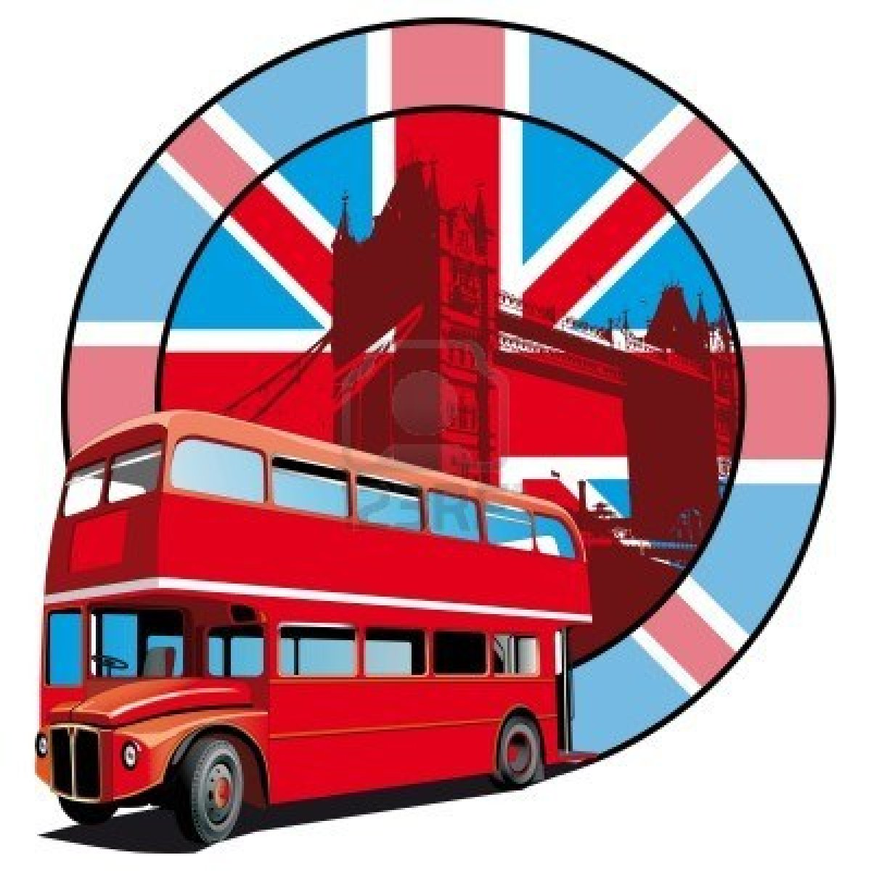
«Знаю ли я Великобританию».
Викторина

Slide 2
What is the official name of the country which call Great Britain?
The United Kingdom of Great Britain and Northern Ireland

Slide 3
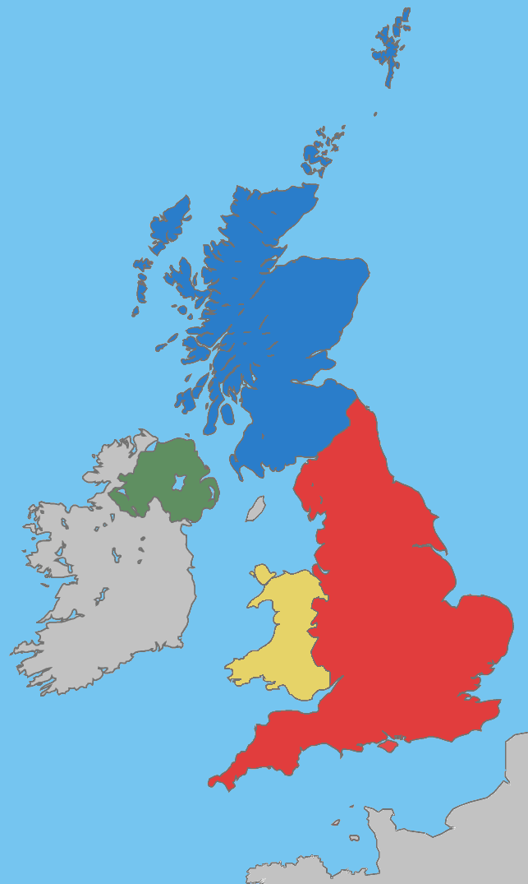
Name the capitals of England, Scotland, Wales and Nothern Ireland.
. Edinburgh
.Belfast
.Cardiff
.London

Slide 4
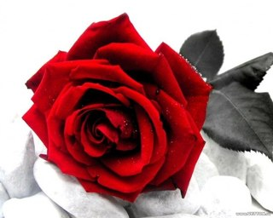
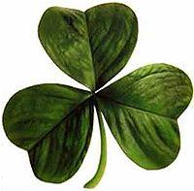
The emblems of the UK
thistle
National symbol of England
Scotland
yellow daffodil
shamrock
a leek
National symbol of
Northern Ireland
National symbol of Wales

Slide 5
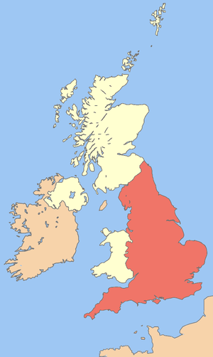
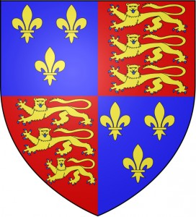
http://vk.com/away.php?to=http%3A%2F%2Fmipolygloti.ru%2Fdokumentalnyie-filmyi-na-angliyskom%2Fobuchayushhee-video-o-britanii

Slide 6
Answer the questions
How many people live in England?
How many people live in London?
Where does the Prime Minister live?
Where does the Queen live?
What is Stratford-upon-Avon famous for?
What is Liverpool famous for?
Name two famous universities in England.

Slide 7
What do you know about British flag?
What colours are there on the flag?
What is the name of the flag?
What have you learnt from the history of the British flag?

Slide 8
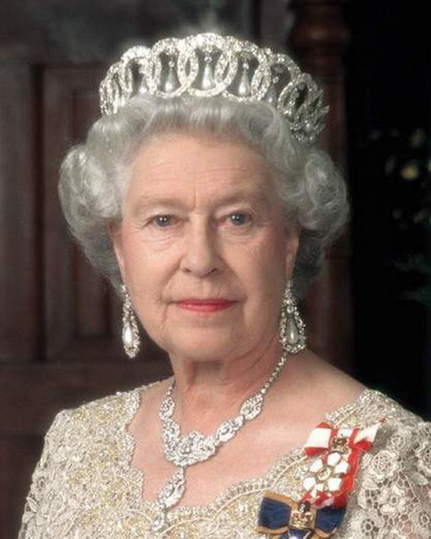
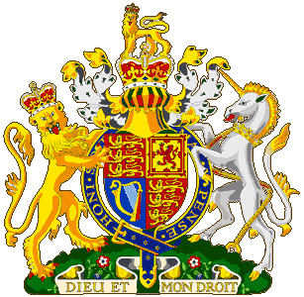
National symbols of the UK

Slide 9
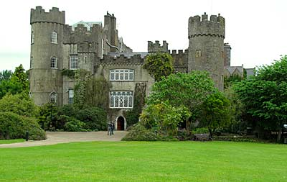
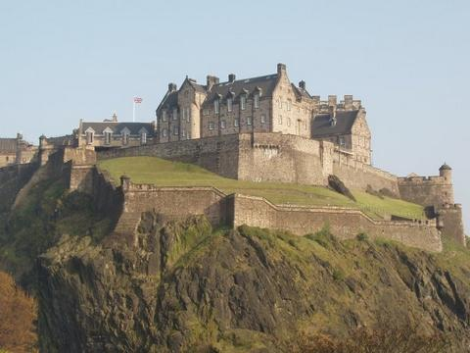
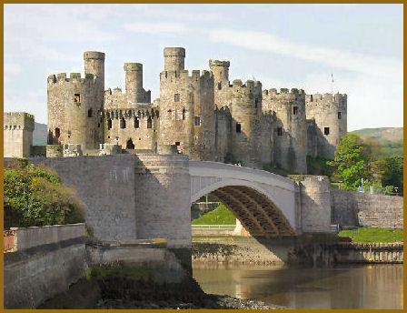
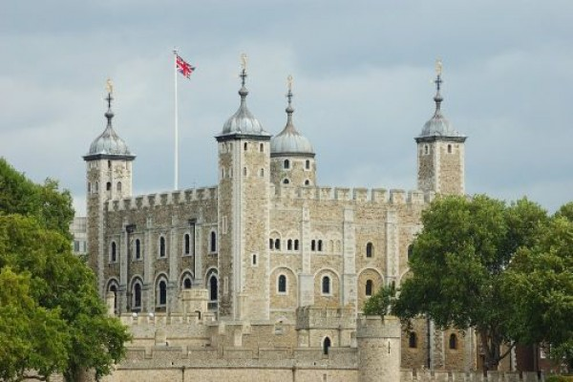
Name the castles

Slide 10
Can you name the landmark castles of the British isles?
Malahide Castle
Edinburgh Castle
The Tower of London
Conwy Castle

Slide 11
What sights can you see?

Slide 12
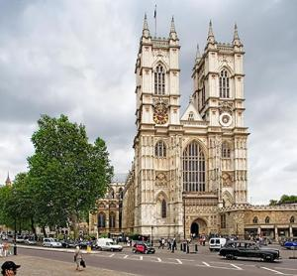
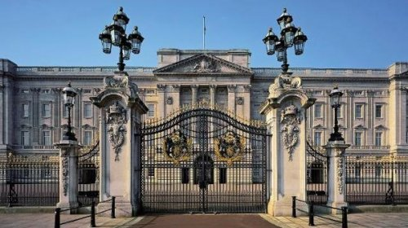
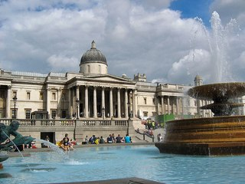
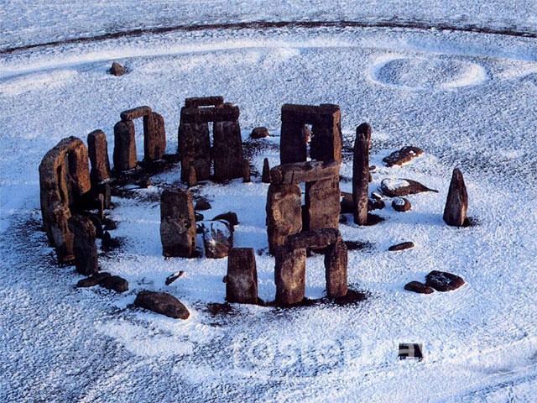
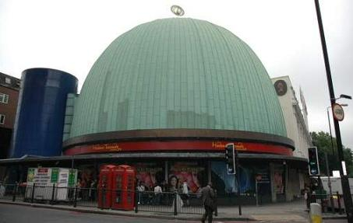
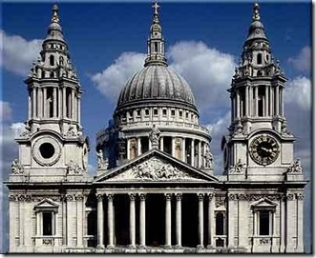
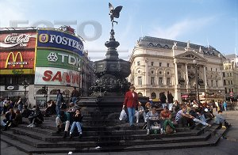
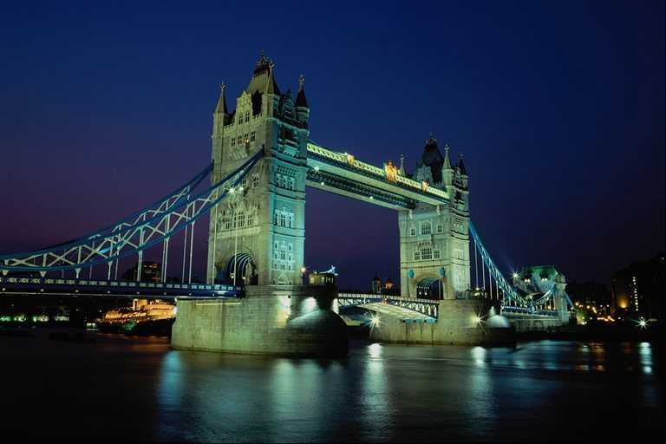
Name as many sights as possible.
1
2
3
Buckingham palace
National gallery
Westminster Abbey
5
6
Stonehendge
Madame Tussauds's museum
4
planetarium
9
Cathedral of Saint Pavel
7
8
Tower bridge
Pikadilli-Syorkus Square

Slide 13
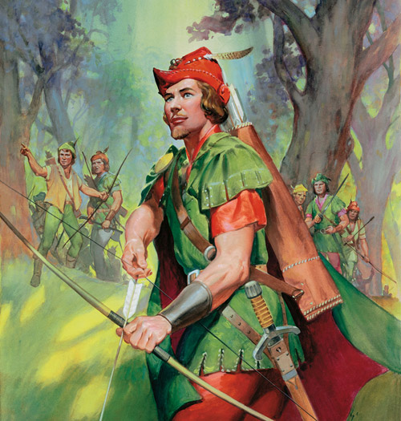
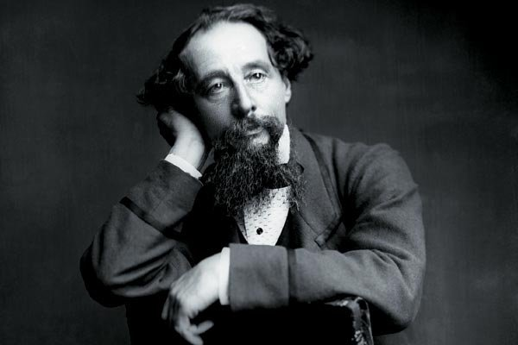
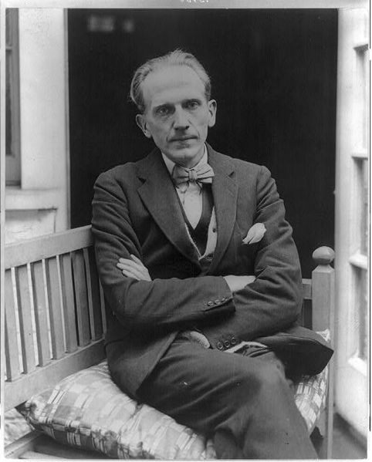
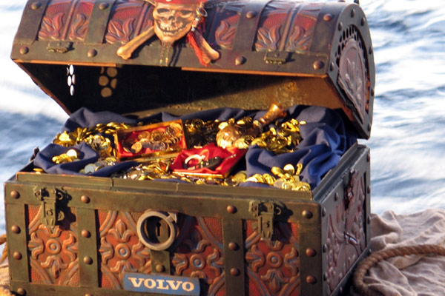
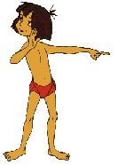
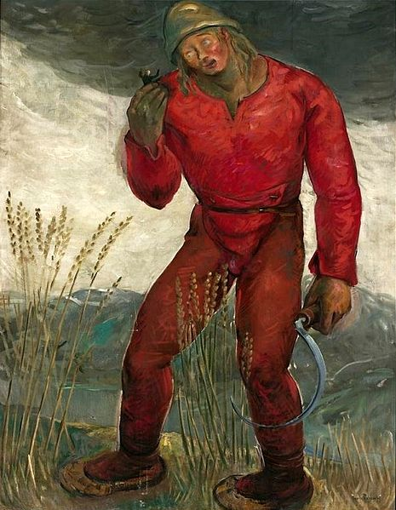
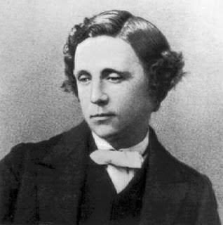
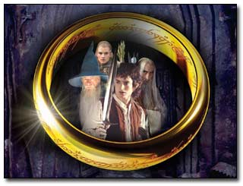
Do you know English writers and books?
Who wrote the books about the teddy bear Winnie-the-Pooh?
What book did this picture come from?
Where did this chest come from?
Who wrote about a crime?
Who wrote Oliver Twist ?
Where did this character come from?
Who is he?
What novel did they come from?
Listen to the extract from the book (what book is it? Who is the author?)
Who lived in Sherwood Forest?
Alan Alexander Milne
Lewis Carroll

Slide 14
Read and find the equivalent
1.My home is my castle.
2.There is no place like home.
3.East or West – home is best.
4.Charity begins at home.
5.Every bird likes its own nest.
6.Home, sweet home.
А.Нет места лучше, чем дома.
B. Милосердие начинается дома.
C.В гостях хорошо, а дома лучше.
D.Каждая птица любит своё гнездо.
E. Мой дом – моя
крепость.

Slide 15
1.My home is my castle.
2.There is no place like home.
6.Home, sweet home.
3.East or West – home is best.
4.Charity begins at home.
5.Every bird likes its own nest.
E. Мой дом – моя
крепость.
А.Нет места лучше, чем дома.
C.В гостях хорошо, а дома лучше.
B. Милосердие начинается дома.
D.Каждая птица любит своё гнездо.

Slide 16
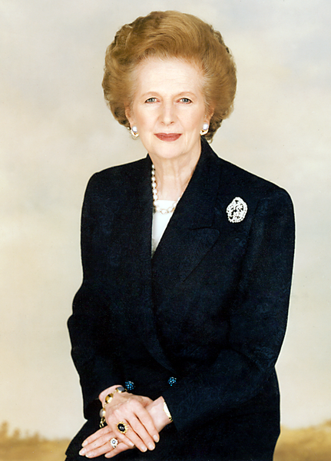
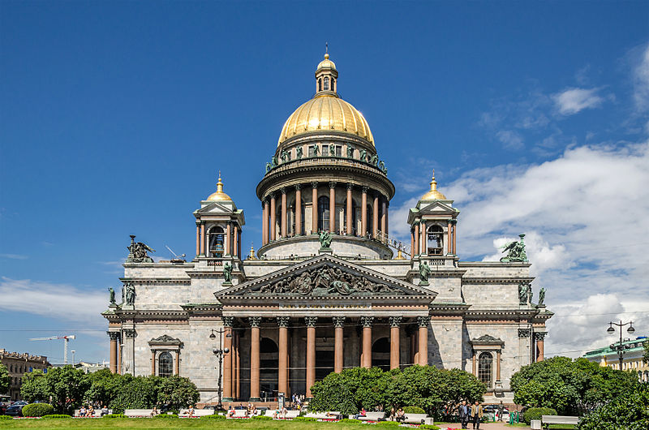
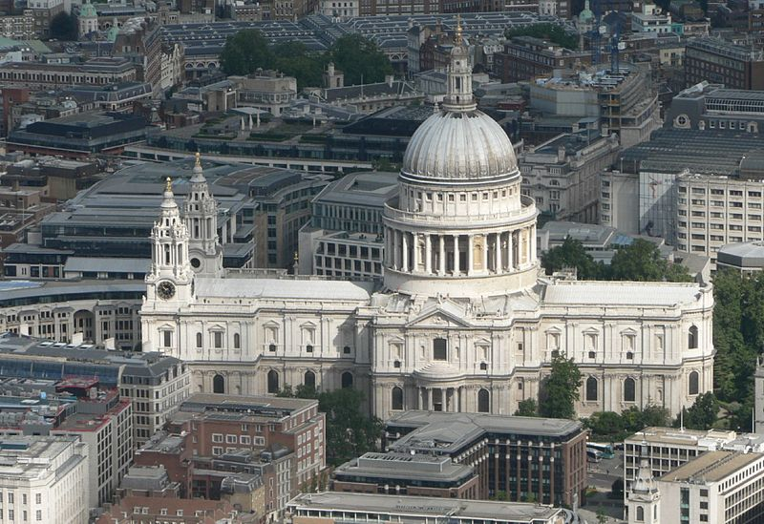
Complete the sentence.
In St.Petersburg it is Pulkovo, but in London…
ABBA is Swedish pop group formed in Stockholm, but the “Beatles "were born …
In Ethiopia it is coffee, but in England…
In Russia tea is with lemon, in England it is with…
A. Montferrand built Saint Isaac's Cathedral, Christopher Wren…
…was called “ An Iron Lady”.
Heathrow
In Liverpool
tea
milk
St Paul's Cathedral in London
Margaret Thatcher

