Slide 1
This is London
Учитель английского языка Вершкова Елена Станиславовна
г. Санкт-Петербург
2013 г.

Slide 2
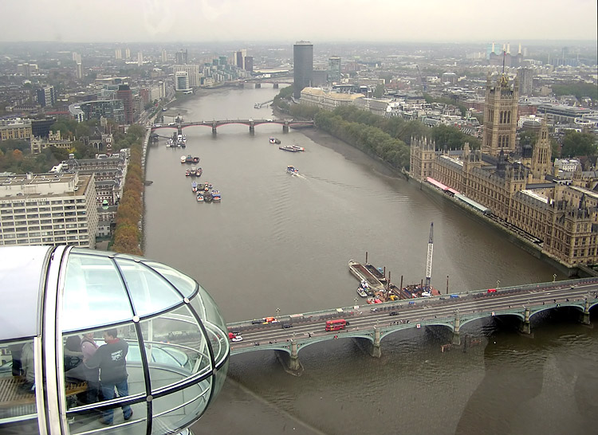
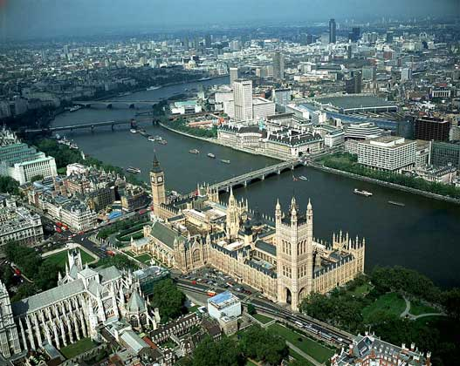
London
London is the capital of the United Kingdom and the centre of the Commonwealth. It lies astride the river Thames in south-eastern England, 50 miles (80 km) from the river’s estuary on the North Sea. The city was once the industrial, commercial, and political hub of a wealthy and extensive empire; it continues to be the United Kingdom’s main centre of population, commerce, and culture.

Slide 3
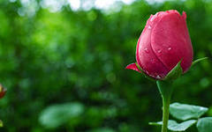
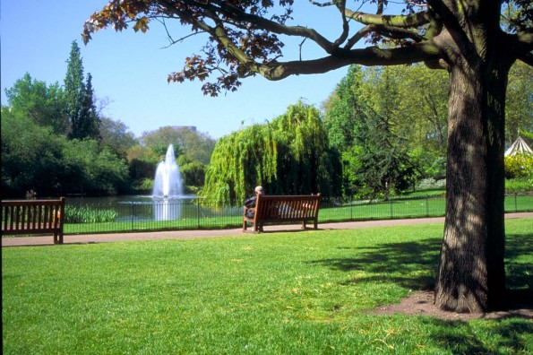
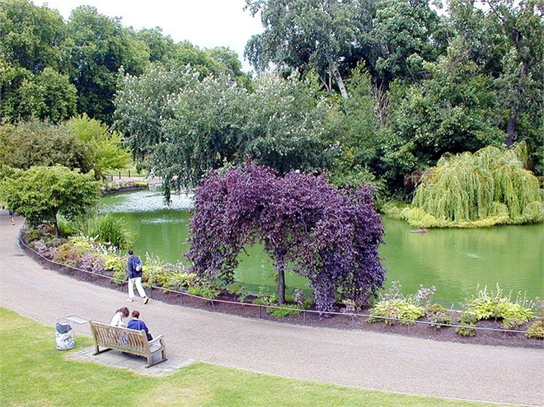
The green London
Parks, gardens, and churchyards abound in Inner London. The most celebrated parklands are the six royal parks that sweep through royal parks, bordered on the east by the royal residence; Green Park, plainest of the royal parks but fringed on the east by lavish, once-private buildings;

Slide 4
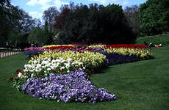
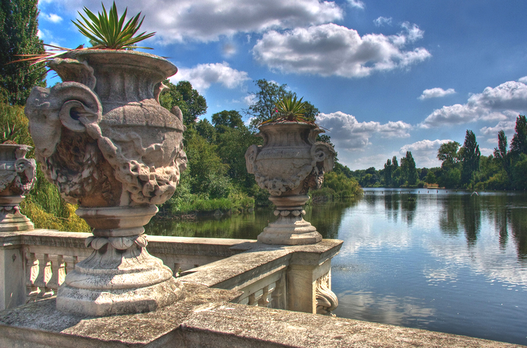
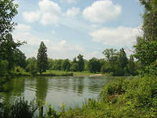
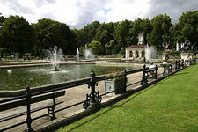
Hyde Park, with its famous Speakers’ Corner for soapbox orators; the more elegant Kensington Gardens, with the Victorian Gothic Albert Memorial and an 80-acre (32-hectare) cultural centre; and Regent’s Park, home of the Zoological Gardens and Regent’s (Grand Union) Canal.

Slide 5
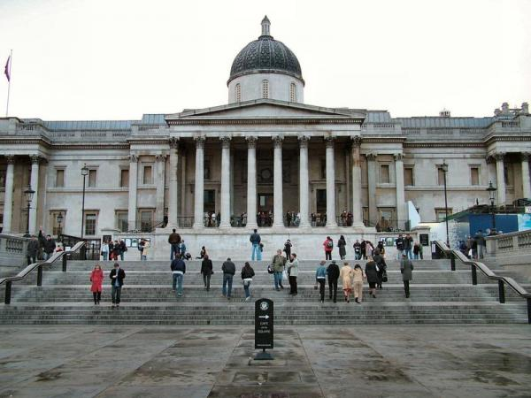
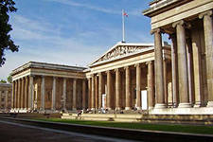
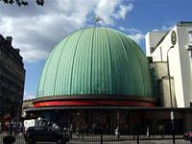
Tourist London
The London known to international visitors is a much smaller place. Tourist traffic concentrates on an area defined by the main attractions, each drawing between one and seven million visitors in the course of the year: the British Museum, which houses collections of antiquities, prints, and manuscripts and the national library, the National Gallery, Westminster Abbey, Madame Tussaud’s waxwork collection, the Tower of London, the three great South Kensington museums

Slide 6
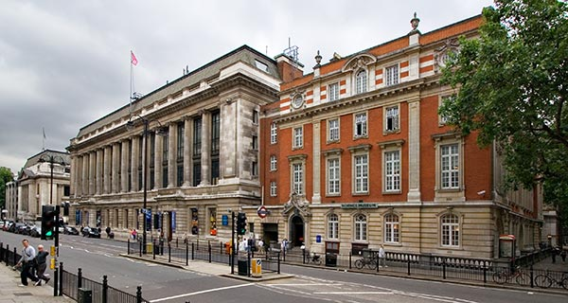
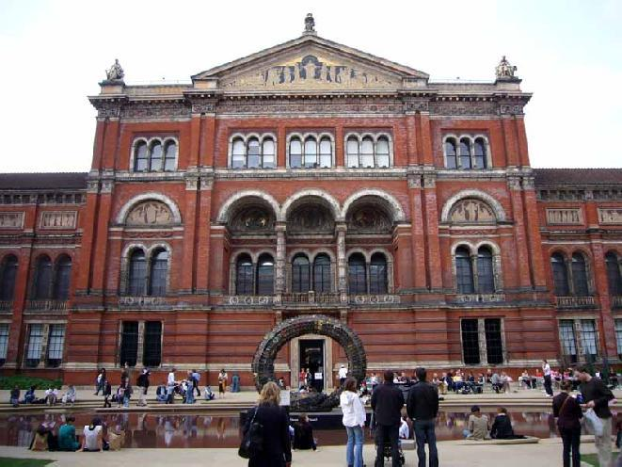
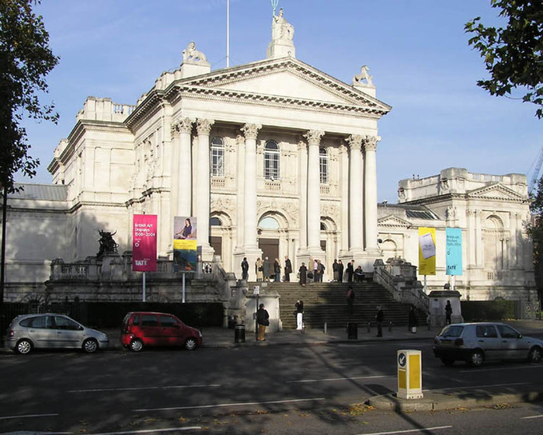
Natural History, Sciensce, and Victoria and Albert Museum of decorative arts, the Tate Gallery; the Victoria and Albert; among other major cultural institutions is the music and arts complex located on the South Bank of the Thames, begun in 1951 for the Festival of Britanin.

Slide 7
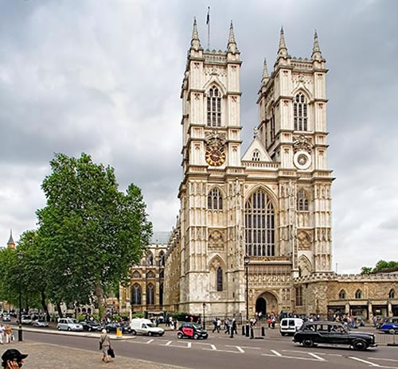
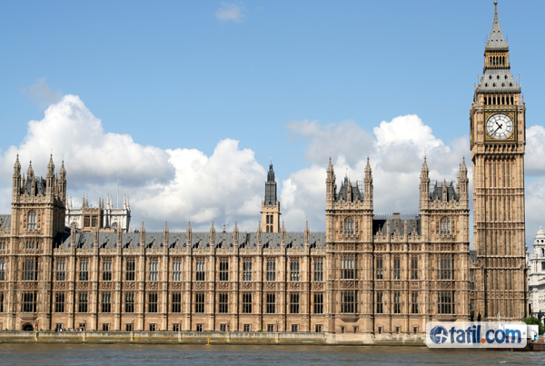
Westminster
Westminster has been a sacred site for as long as history records and a centre of government for over nine hundred years. Here you can see more famous London landmarks than in any other part of the capital: Westminster Abbey, the Houses of Parliament, Whitehall, Downing Street.

Slide 8
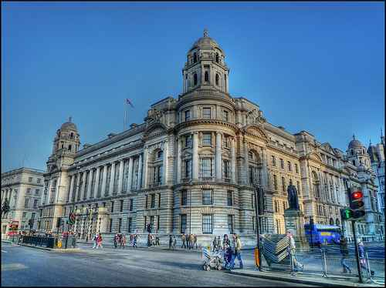
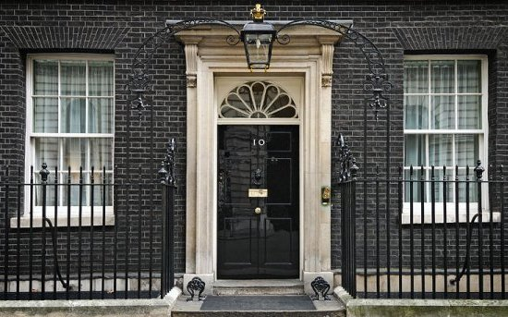
Today, Westminster is still the centre of government. The Queen was crowned at Westminster Abbey. Her government meets beneath the crown-yipped, fancy pinnacles of the Palace of Westminster, where MPs burst blood vessels in fiery debates. Whitehall is lined with corridors of the government machine. At Trafalgar Square it meets the Mall, the royal processional route.

Slide 9
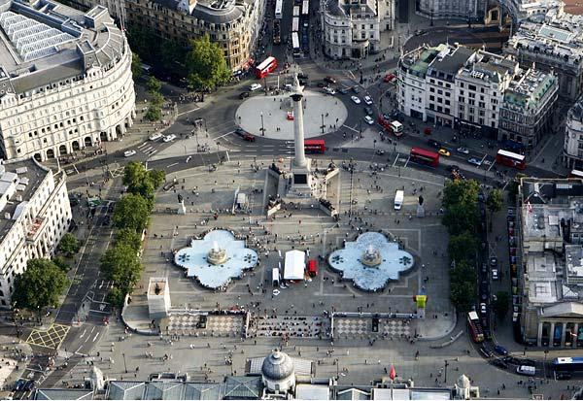
Trafalgar Square
We’ll start our journey through Westminster on Trafalgar Square. It honours Horatio Viscount Nelson (1758-1805), who went to sea triumphs was created Baron Nelson of the Nile before being killed as he defeated the French and Spanish at Trafalgar in 1805.

Slide 10
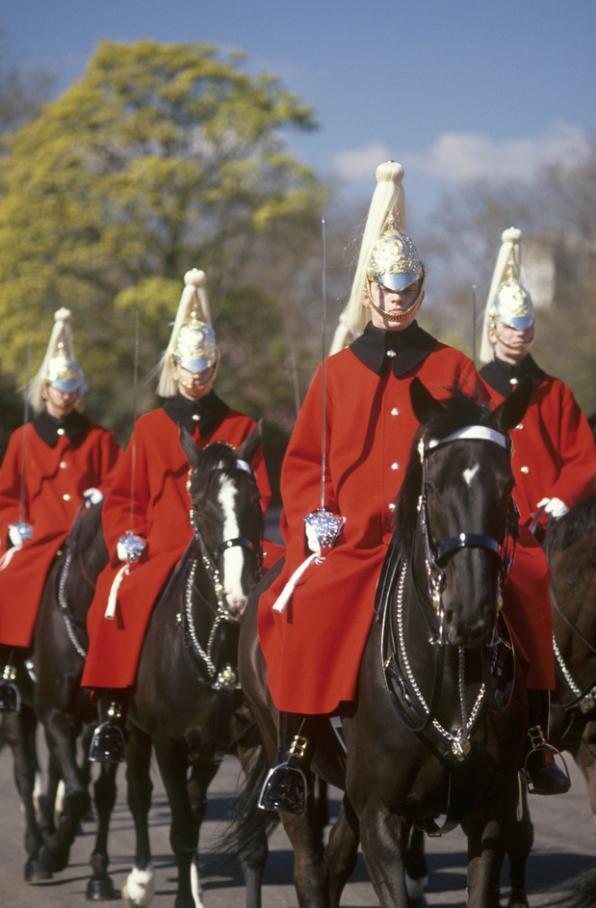
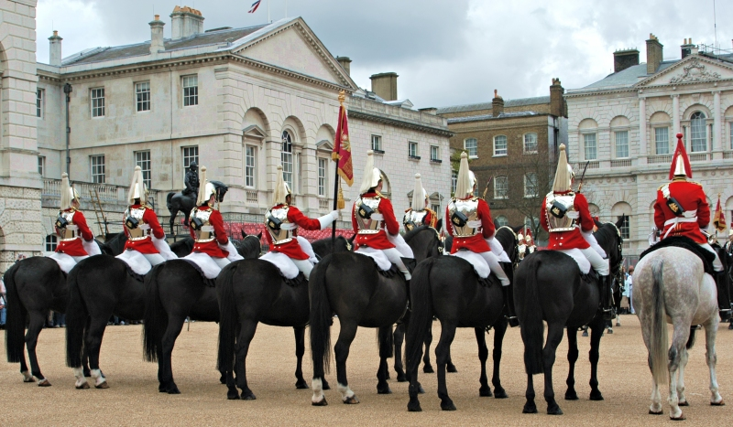
Horse Guards. Trooping the colour
Going down Whitehall you’ll see on your right Horse Guards, the building with two sentries outside. It’s a pleasant grey stone building with a low clock tower and two stone guard boxes. It was built by William Kent and John Vardy in 1745-55 on the site of the place where the knights used to joust. Through the arch to the Park side you can see the open parade ground called Horse Guards Parade, and it’s here on her official birthday, on a Saturday in June, that the Queen reviews her guards at the Trooping the Colour.

Slide 11
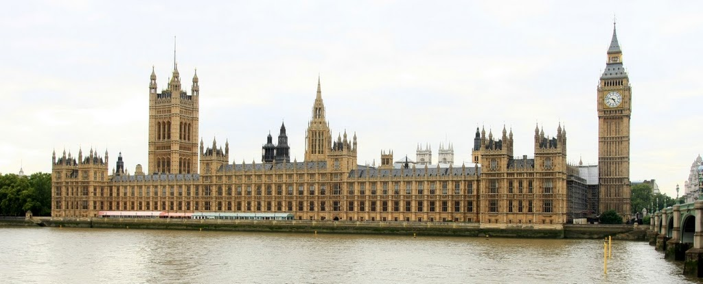
Palace of Westminster
Going back to the centre of the bridge you can see one of London’s most spectacular sights – the stunning river panorama of the Palace of Westminster, the mother of parliaments, spread over 8 acres with two large towers at either end – the huge square Victoria Tower to the left end and the more slender and original Clock Tower, known as Big Ben, on the right.

Slide 12
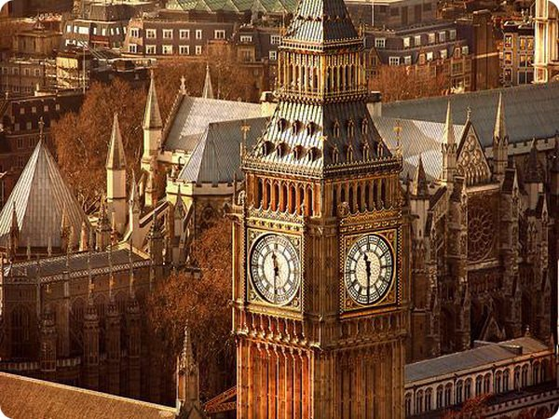
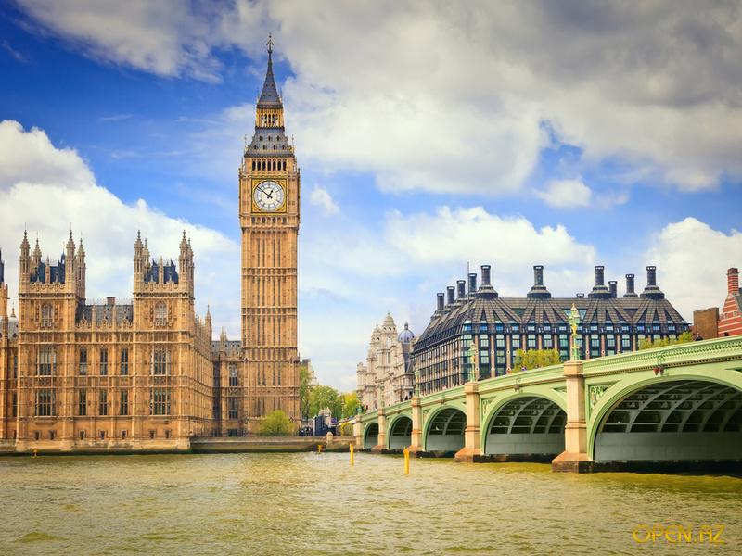
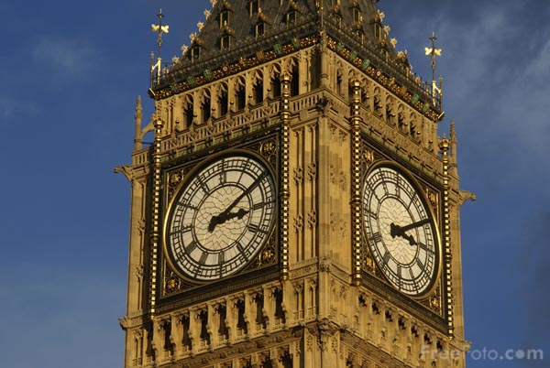
The name actually refers to the mighty 13-ton bell which strikes the hours. The minute hands on the clock’s four 23 feet-wide dials are each as tall as a doubledecker bus, and the clock is still wound by hand. The bell is named after Benjamin Hall, who was Commissioner of the Works at the time the clock was installed. When Parliament is in session, the Union Jack flies from Victoria Tower, and by night a light shines from the Clock Tower.

Slide 13
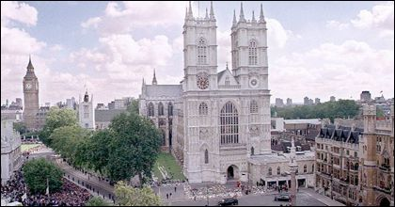
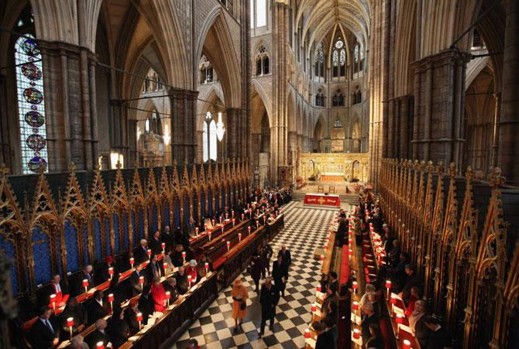
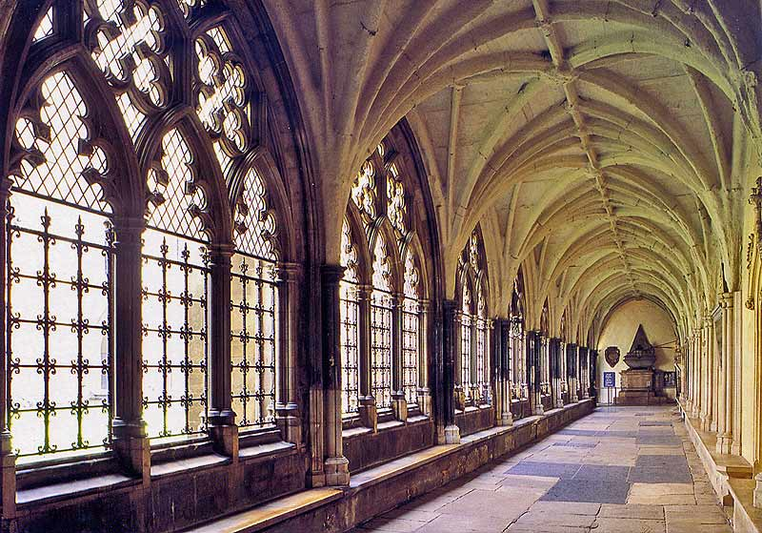
Westminster Abbey
It is a building great west porch of British history. Every ruler has been associated with it, and more than 5000 people are remembered inside. Edward the Confessor was determined to have the abbey at Westminster enlarged and made the crowning place of English kings. It was consecrated on the 28th of December in 1065 and eight days later Edward died and was buried behind the high altar. His successor Harold was crowned here been crowned, married and buried here.

Slide 14
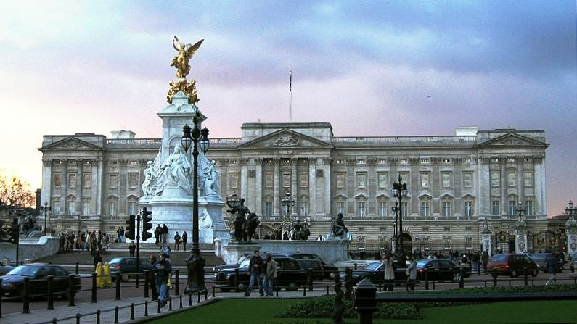
Buckingham Palace
On the left, across Birdcage Walk, almost towards the end of the park, are Wellington Barracks. Leaving the park, if you turn to the right, you’ll come to the open circus, or space, in front of Buckingham Palace. In the centre is the memorial to Queen Victoria. Of the nine statues of her in London this is the most lavish and its creator won a knighthood for it.

Slide 15
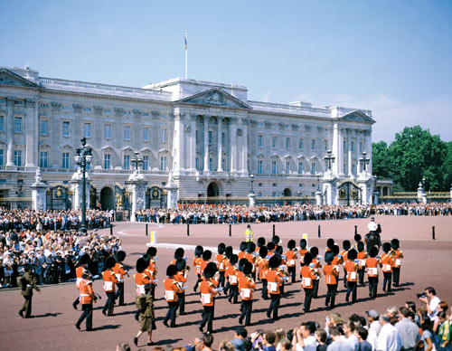
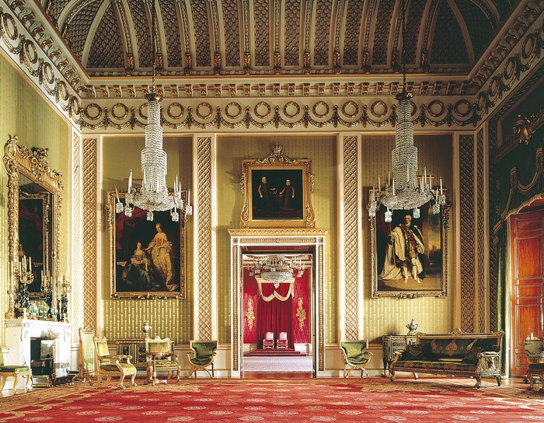
The ceremony of Changing of the Guard with its music, marching and magnificent solemnity takes place here at 11.30 in the morning. The new guard touch hands with the old guard to symbolise handing over the keys. You can tell whether the Queen is in residence by the Royal Standard flying on the flagpole in the centre of the building.

Slide 16
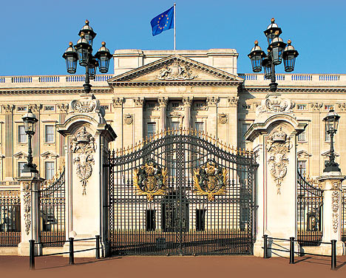
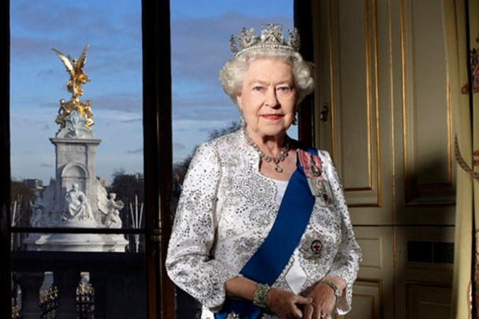
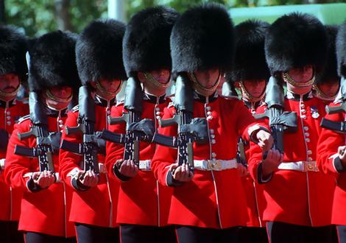
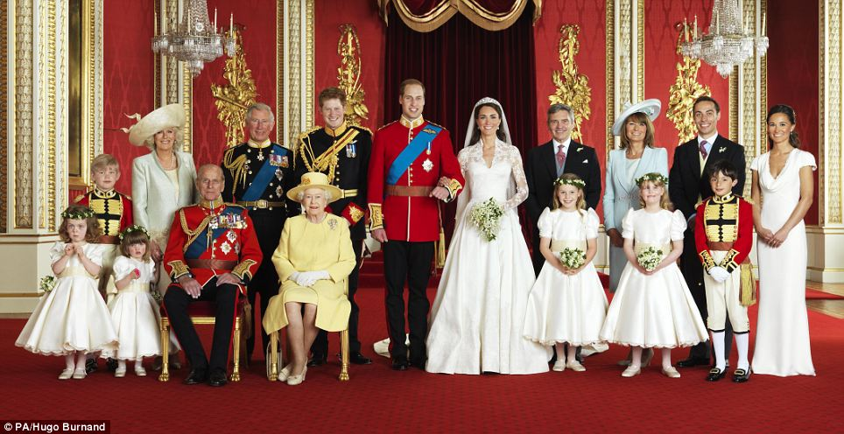

Slide 17
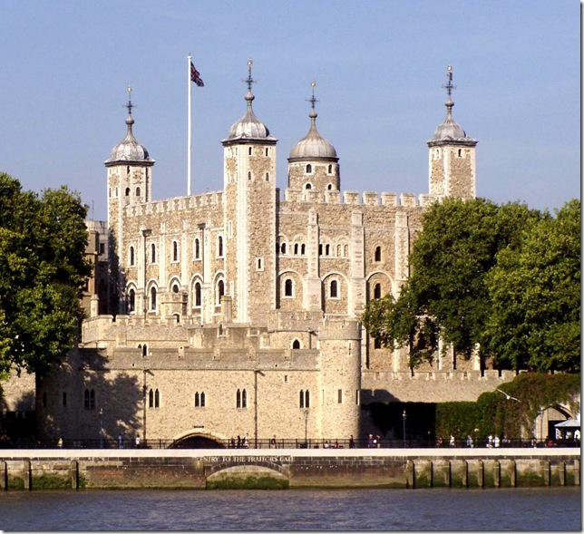
The Tower
The Tower of London, one of the most imposing fortresses in England, as well as the best known, stands on the north bank of the Thames a little below London Bridge, on the east side of the City of London. Begun by William the Conqueror with the triple object of protecting the city, overawing its citizens, and controlling the approaches t London by river, it has been altered and added to by many succeeding monarchs

Slide 18
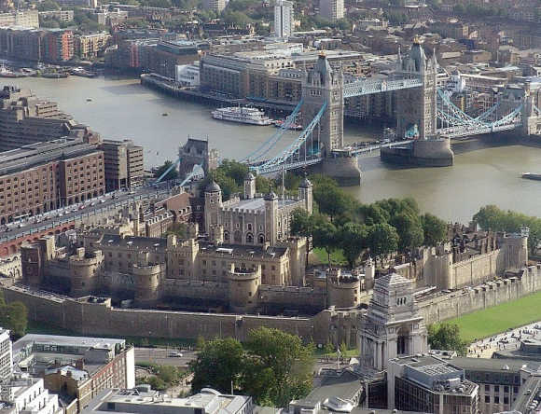
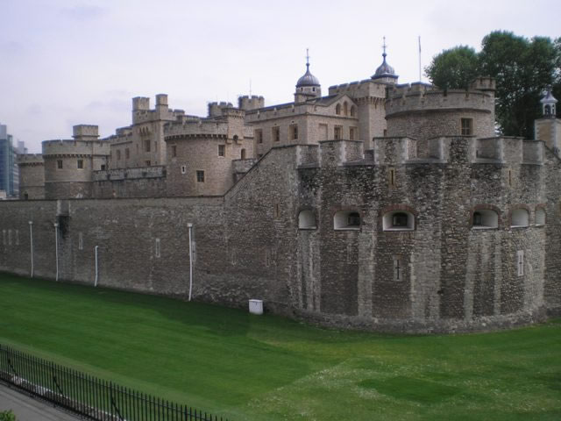
The Tower has been in its time a citadel, a royal palace and a state prison; it is still an arsenal maintained by a garrison, and in the World Wars it was again used as a prison. Though often attacked and besieged, it has never been captured. Now it is London’s smallest village, covering 18 acres. 55 families live here, tending their geraniums and playing bowls on the ex-moat, their village green.

Slide 19
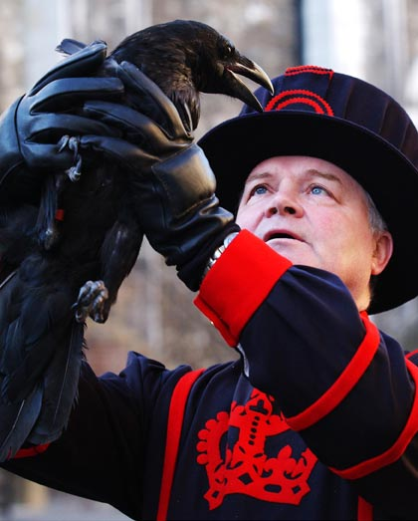
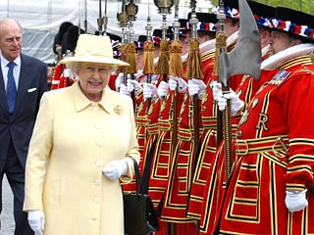
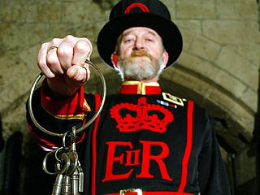
The Deputy-Governor lives in sleeping quarters used by Edward I, Edward II and Edward III, one of the 42 Yeoman Warders, founded by Henry VII in 1485, lives where the Royal Mint was in 1590. But each night they still ceremoniously lock the gates against the dangerous London mob.

Slide 20
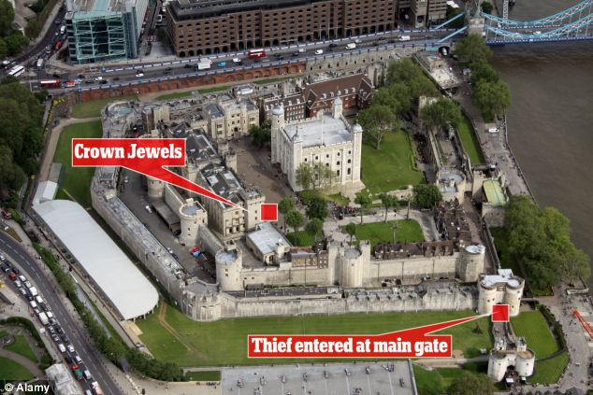
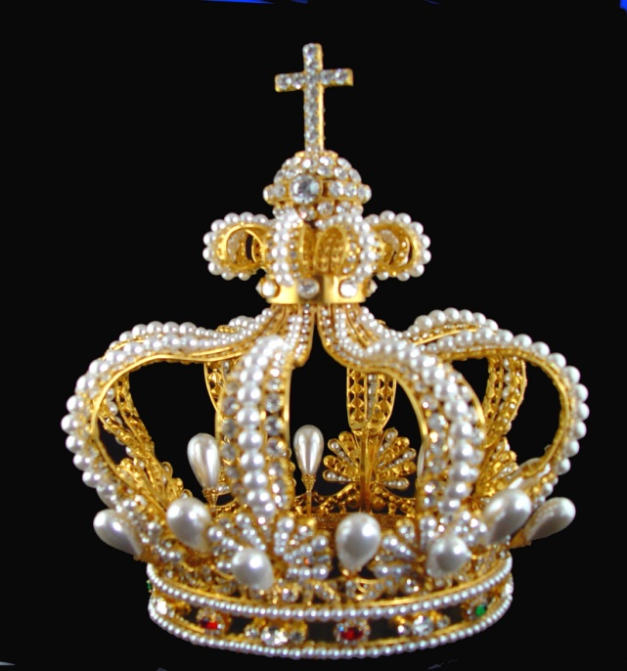
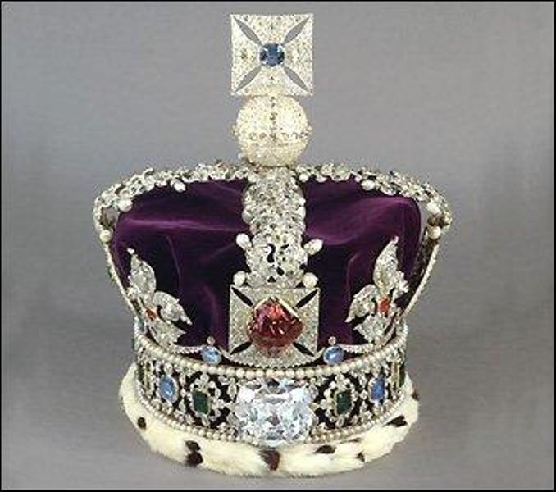
The Tower attracts so much interest because it’s closely associated with ,any important events in English history and also because of the excellence of its medieval fortifications.

Slide 21
Exercises
Answer the questions.
1.Where is London situated?
2.Why is London important for the United Kingdom?
3.Which of London’s parklands are the most celebrated?
4.Where are the Zoological Gardens situated?
5.What does visitors’ London consist of?
6.What are London’s main attractions for tourists?
7.Why is Westminster an important part of London?
8.When did the history of Westminster begin?
9.Where is the Horse Guards building situated?
10.What ceremony takes place on Horse Guards Parade?
11.What does the ceremony take its name from?
12.How many birthdays does the Queen have? Why?
13.What territory does Westminster Palace occupy?
14.What does the name Ben refer to? Where does it come from?

Slide 22
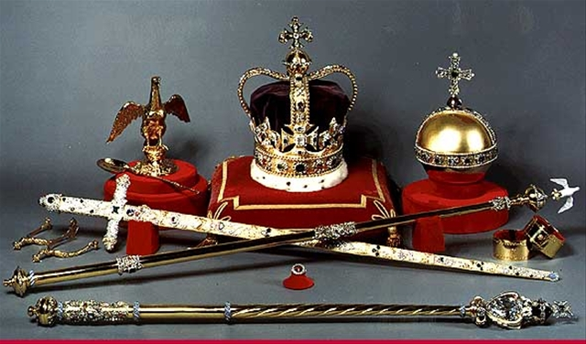
15.Why is Westminster Abbey important?
16.Where is the Tower situated?
17.How was the Tower used in the course of its history?
18.What is the Tower now?
19.Why is the Tower popular?
20.Where is the memorial to Queen Victoria situated?
21.Where and when does the ceremony of theChanging of the Guard takes place?

