Slide 1
Olympic Games Citius, altius, fortius F a s t e r ! H i g h e r ! S t r o n g e r !

Slide 2
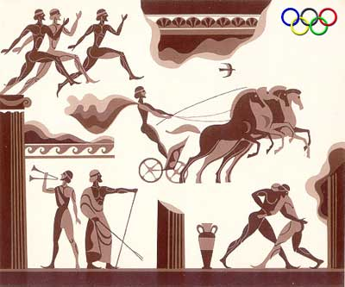
The Olympic games are known as the worlds greatest international sports games.
The Olympic idea means friendship and cooperation among
the people of the
world. The Olympic
Games have
a very long history.
They began in 776 BC
in Greece.

Slide 3
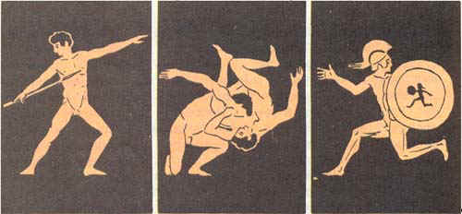
The Olympic Games took place every four years. They included different kinds of sports: running, boxing, wrestling and many others. For the period of the Games all the wars stopped. So the Olympic Games became the symbol of peace and friendship.

Slide 4
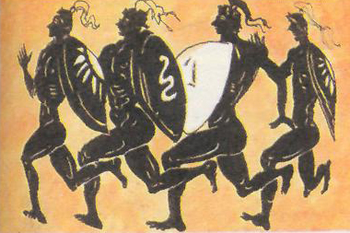
The games were for men only. Greek women were forbidden even to attend the Olympics.

Slide 5
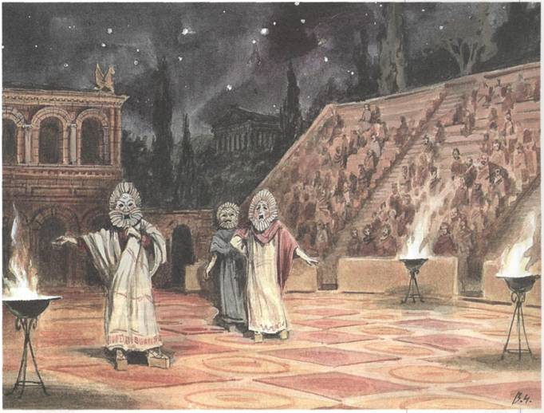
These games were part of a festival held every fourth year in honor of the God, Zeus at the place called Mount Olympus.

Slide 6
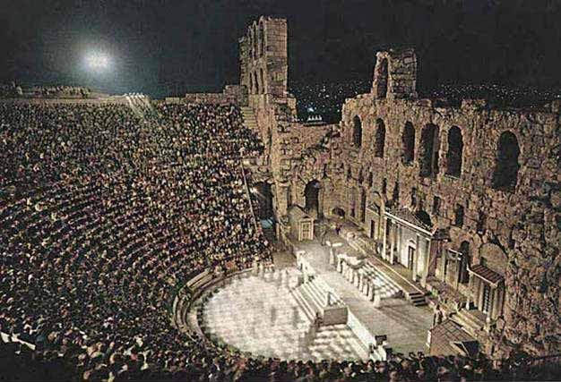
Olympia is located in the northwestern part of the Peloponnese peninsula. Olympic sanctuary remained the focus of Greek art up to IV BC.

Slide 7
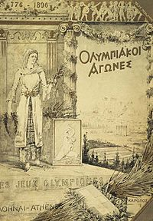
The revival of the Olympic idea
In 394 AD the Games were abolished . In 1896 the modern Olympic Games were renewed. They took place in Greece to symbolize the continuation of the centuries-old.

Slide 8
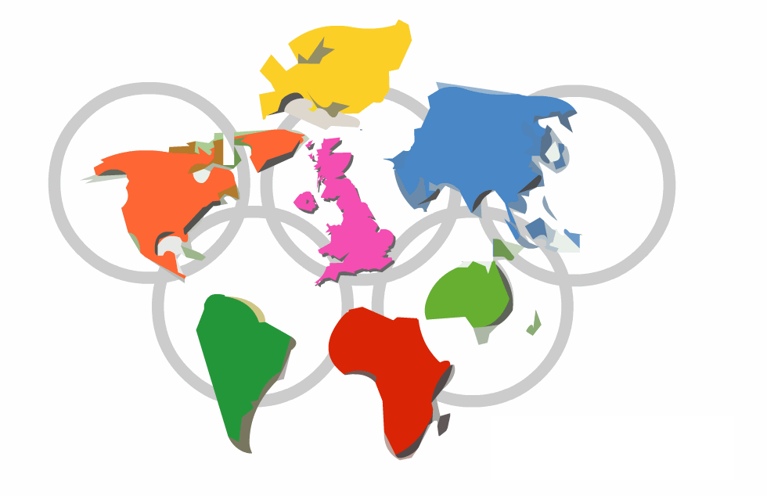
Olympic symbols:
The Olympic flag

Slide 9
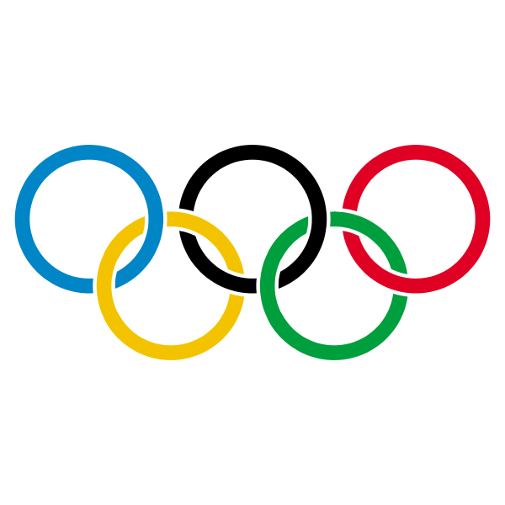
Five interlocked rings of blue, black, red, yellow and green colours symbolize the five continents united into the Olympic movement.
The blue ring symbolizes Europe, the black ring – Africa, the red ring – America, the yellow ring – Asia, the green ring – Australia.

Slide 10
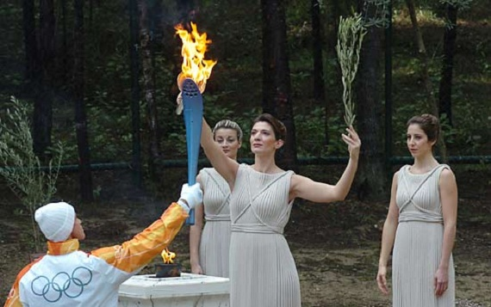
The Olympic flame is the traditional attribute of the Olympic Games. As a symbol of peace among people, the flame represents the basic spiritual significance of this classic competition.

Slide 11
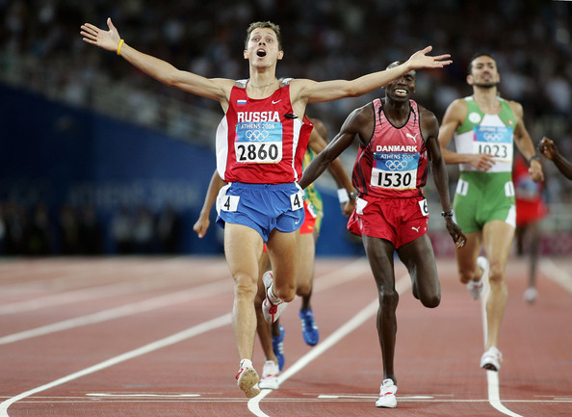
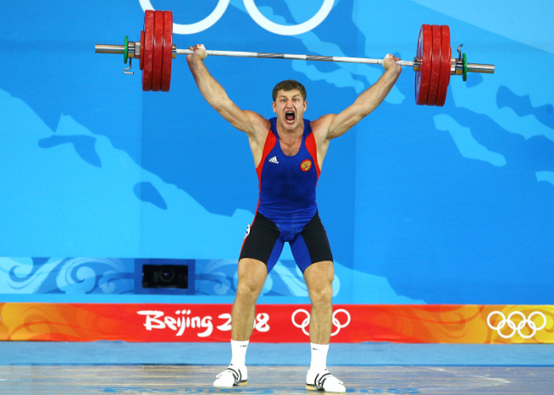
The Olympic motto is «Citius, altius, fortius». These Latin words mean: «Faster, higher, stronger».

