Slide 1
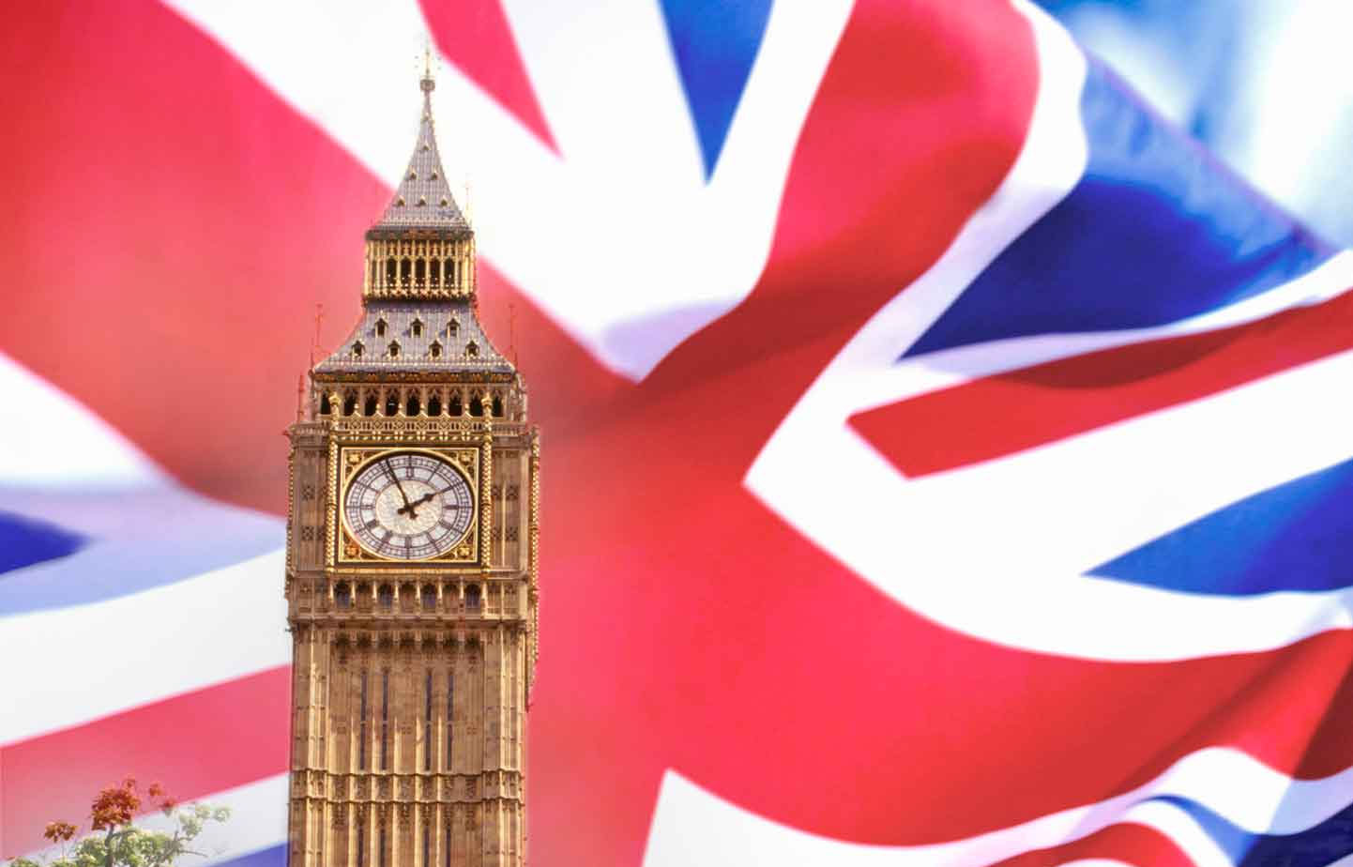
The United Kingdom of Great Britain and Northern Ireland

Slide 2
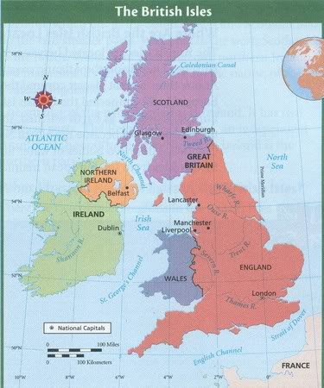
The geographical position of G.B
There are 2 large islands and some smaller ones lie in the north-west coast of Europe. They are the British Isles .The largest Island is called Great Britain. The smaller one is called Ireland.

Slide 3
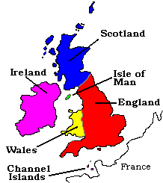
The official name of this country is the United kingdom of Great Britain and Northern Ireland. The second name is Great Britain. It consists of England, Scotland, Wales, Northern Ireland.

Slide 4
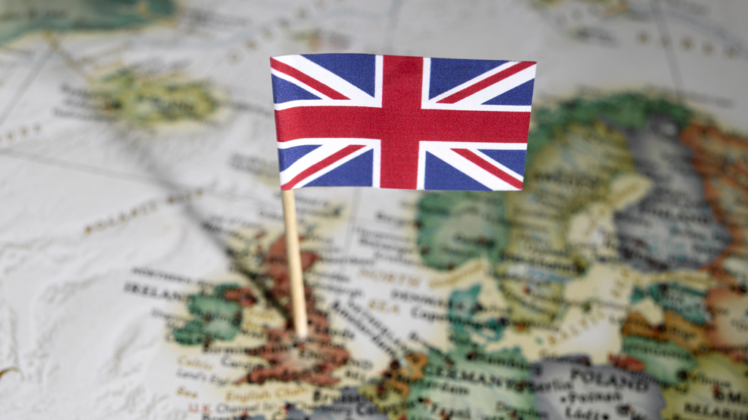
The population of the British Isles.
The British Isles are the home of 4 nations: English, Scottish, Welsh, Irish.

Slide 5
The flag of the UK is called Union Jack. The official language is English.

Slide 6
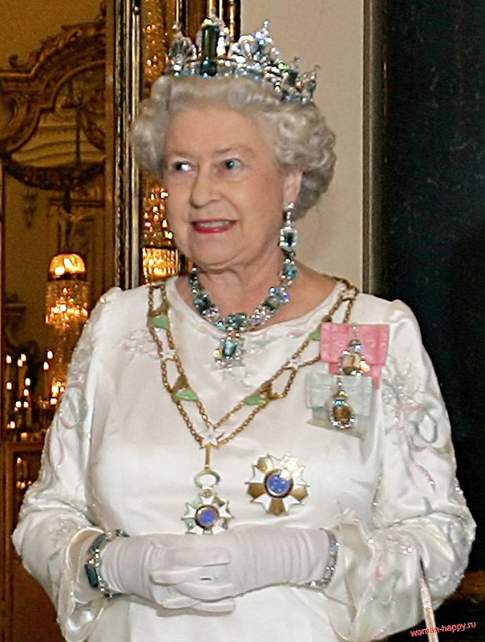
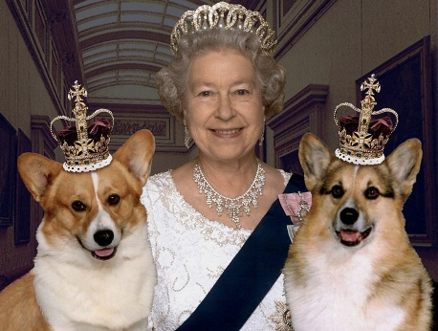
The Chief of the state is Queen Elizabeth II. The head of the government is Prime Minister.

Slide 7
The capital of the UK and England is London. It’s very beautiful and rich city.

Slide 8
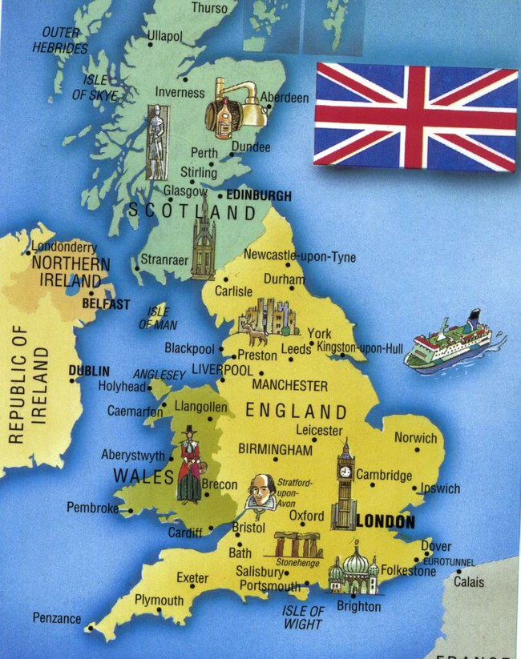
The main industrial and business centres in the UK are Birmingham, Manchester, Leeds, Liverpool, Bristol.

Slide 9
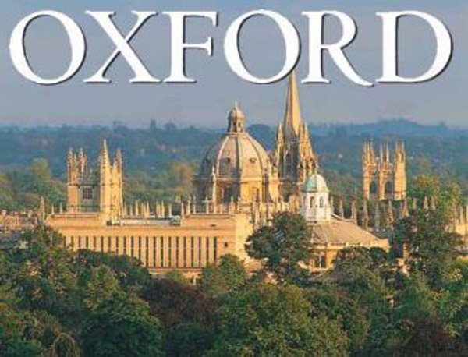
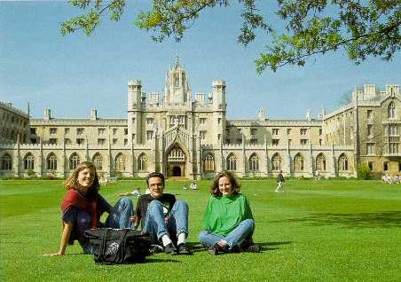
Oxford and Cambridge are famous for the oldest British Universities. Only the children of wealthy people can study there.
Cambridge

Slide 10
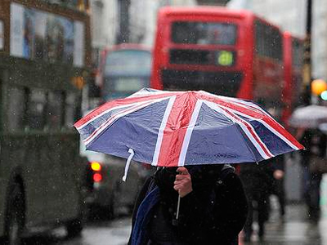
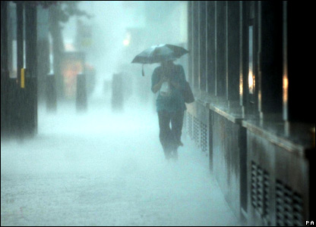
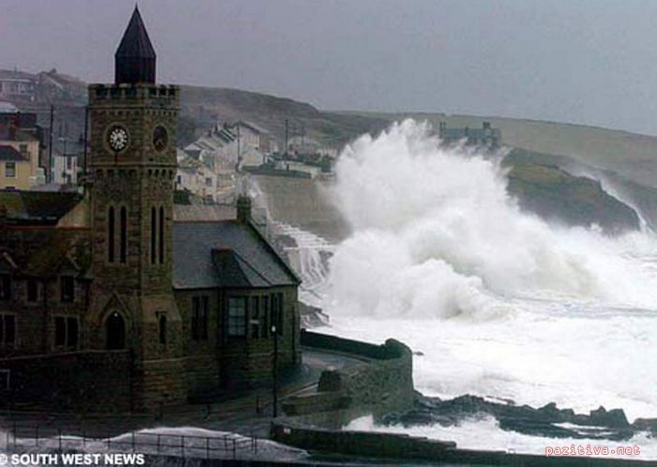
The UK is situated on the islands. So the weather is very changeable. The British people say: “We have no climate, we have only weather.”

Slide 11
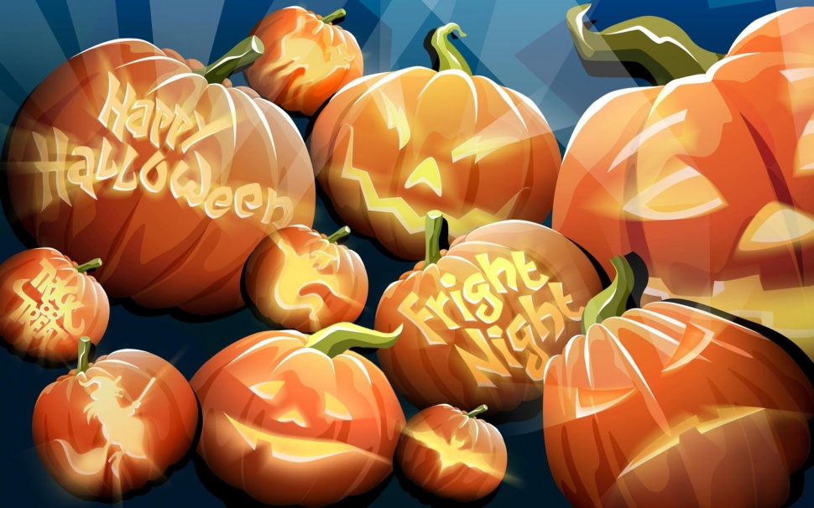
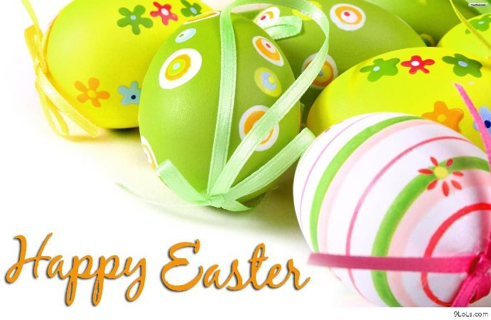
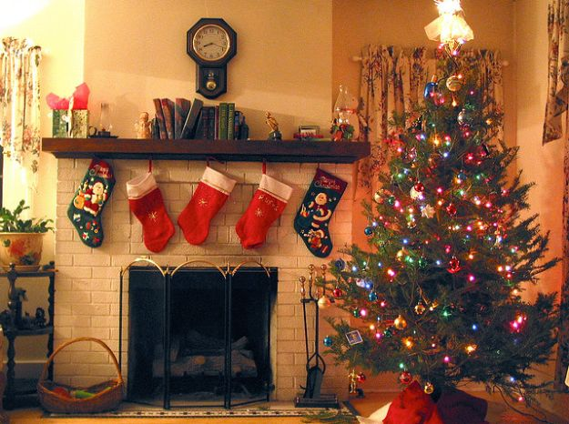
In Great Britain people are rather conservative and they love their customs and traditions more than any other nation in Europe. They are proud of the traditions: Halloween, Easter Sunday, Christmas and New Year’s celebrations.

Slide 12
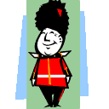
Wellcome to Great Britain!

