Slide 1
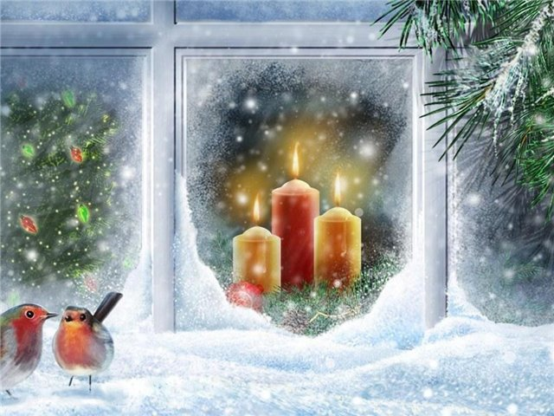
Christmas in Great Britain.

Slide 2
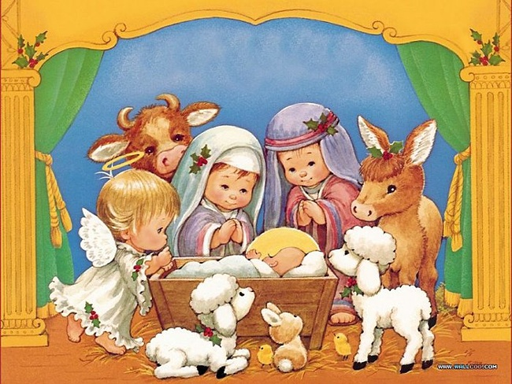
Christmas Day is celebrated on December 25. Many people look at Christmas as the time to celebrate the birth of Jesus Christ, but the legend says in those days the sun meant so much to primitive man that when it began to go lower each day till December 23, people thought the sun was going to die out and they were worried.

Slide 3
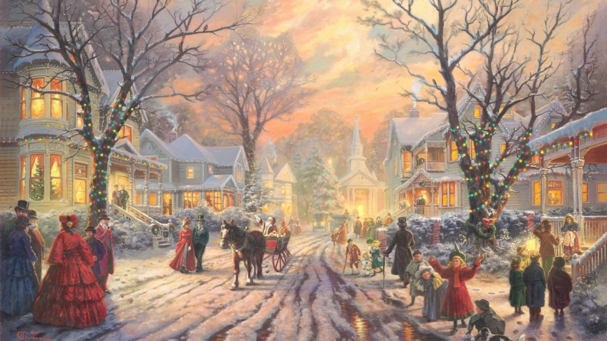
On December 23 the sun stayed in the sky longer. the nights were shorter. The primitive man was very happy. He wanted to celebrate it.

Slide 4
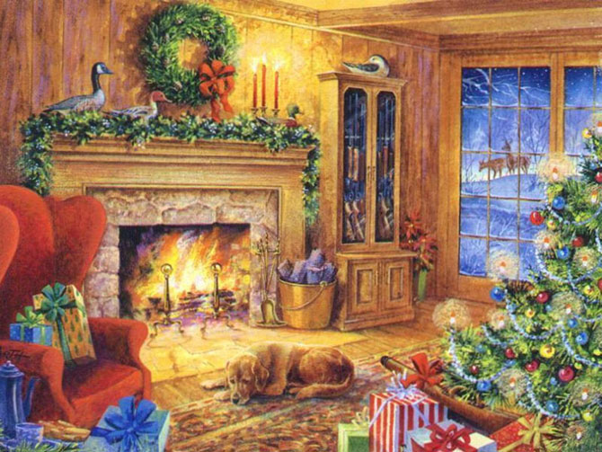
Later it became a tradition to celebrate it. Now Christmas tree stands in everybody’s living-room at Christmas. In the earliest time green trees were symbols of life.

Slide 5
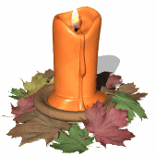
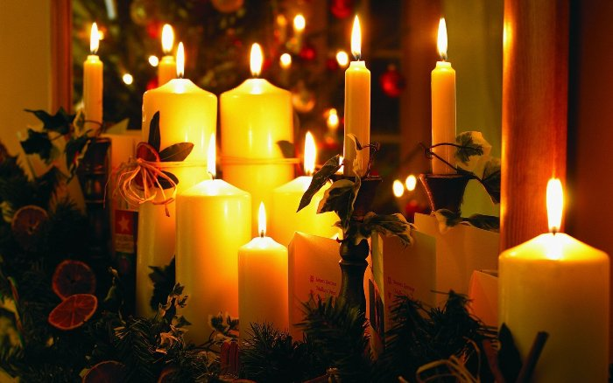
Candles at Christmas also go back to those times. People believed that their light helped them to forget the darkness of winter.

Slide 6
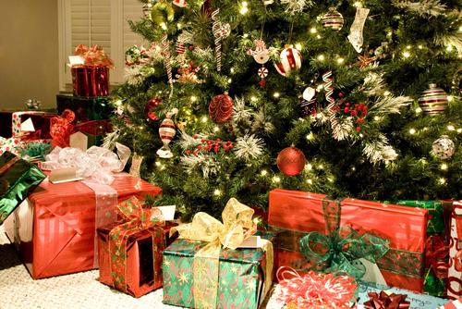
The first weekday after Christmas is a public holiday. In England it is called Boxing Day. In past times it was the traditional day to give presents to servants. this day is called Boxing Day because the presents were put in boxes (Christmas boxes).

Slide 7
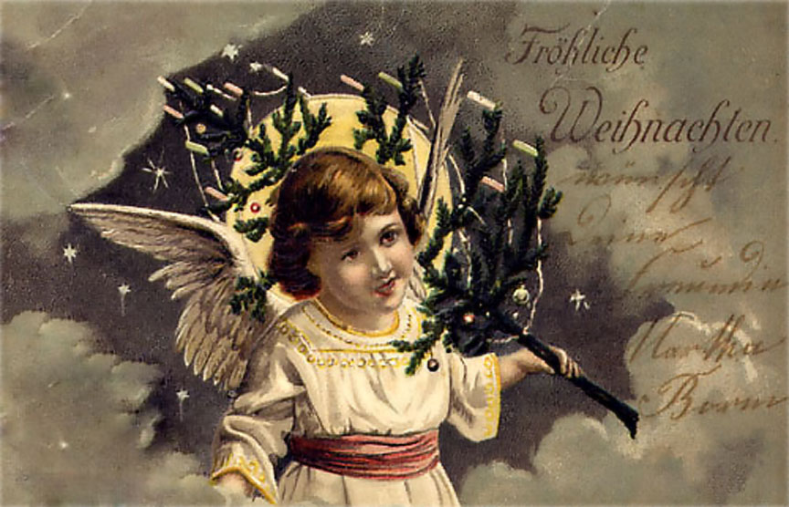
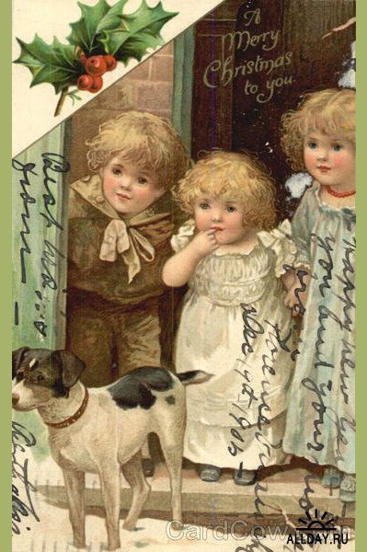
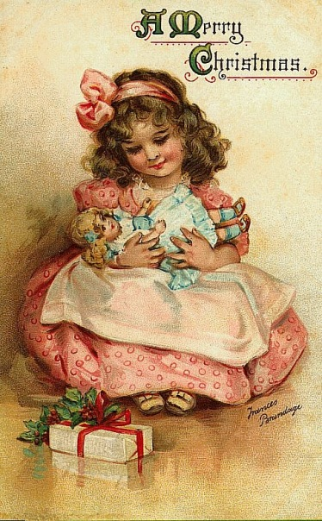
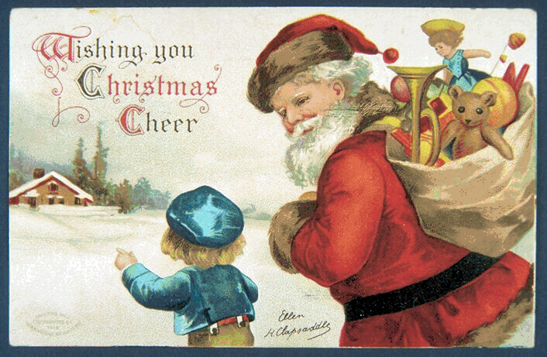
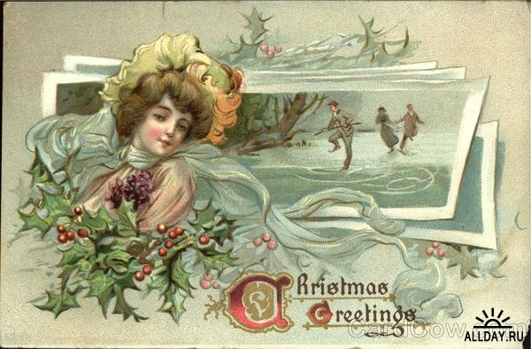
Not all Christmas traditions are old. The first Christmas Card was made only in 1842 by an English painter. He sent it to a hundred of his friends. Now millions of Christmas cards are sent and received.

Slide 8
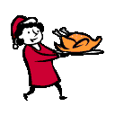
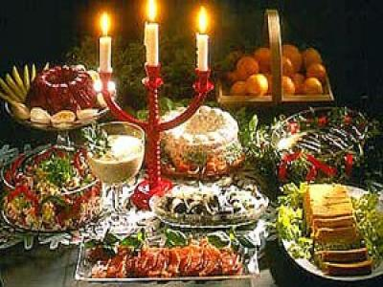
Christmas is the time for eating . The traditional food is turkey, Christmas pudding made of fruit, Christmas cake.

Slide 9
We wish you a merry Christmas!

Slide 10
Questions:
When is Christmas celebrated?
Why did people feel they wanted to celebrate this day?
What stands in everybody,s living-room at Christmas now?
How is the traditional day to give presents called?
When was the first Christmas card made?
What is the traditional Christmas food?

Slide 11
World list:
to celebrate – праздновать
birth – рождение
primitive – примитивный ,простой
to worry – беспокоиться
plenty of – множество, большое количество
candle – свеча
servant – слуга
turkey - индейка

