Slide 1
Christmas
Quiz
Medvedeva Larisa Alexandrovna
English teacher
Lyceum №144
Saint -Petersburg

Slide 2
Warming up
1) a traditional Christmas song
2) a kind of sock which gifts are put in
3) an object used for travel over snow, pulled by animals
4) metal objects which make a noise when hit
5) objects which make a Christmas tree look pretty
6) a model of a person, made of snow, outside in winter
7) gifts
8) a bright light seen in the sky at night
9) the day before Christmas
10) made of wax and string, it burns slowly
a) presents
b) candle
c) bells
d) carol
e) snowman
f) star
g) Christmas Eve
h) Sleigh
i) Stocking
j) Decorations

Slide 3
Christmas tongue twisters
Santa’s sleigh slides on slick snow.
Chilly chipper children cheerfully chant.
Doddy brings bright bells.
Tiny Timmy trims the tall tree with tinsel.

Slide 4
Guess the word
y a j r n u a
n a s m o n w
r y e m r
n oI t I l l u n a m I
t s r f o
January
December
r e m d c e b e
f s k e w o n s l a
s a m e c l t s
a s n a t
w n o s
snowman
snowflakes
merry
illumination
Santa
frost
snow

Slide 5
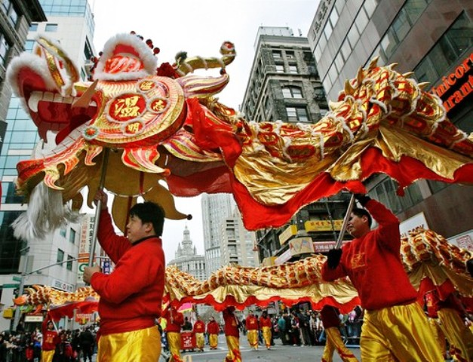
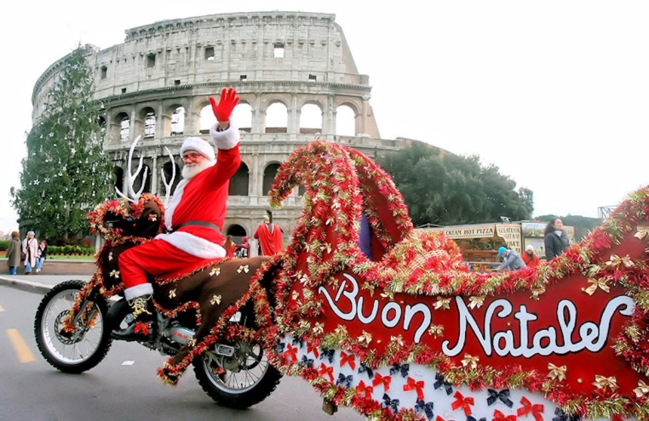
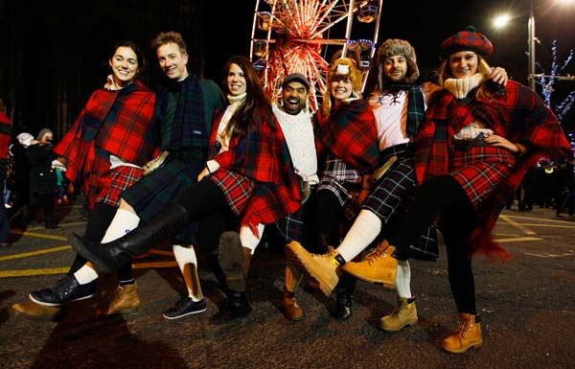
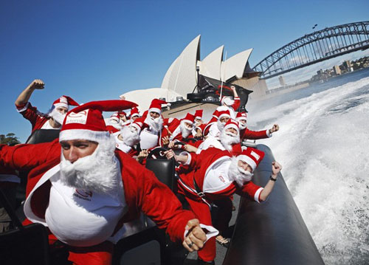
China
№1
Scotland
№2
America
Italy
№5
Australia
№3
№4
Scotland

Slide 6
Pass a stocking

Slide 7
For captains

Slide 8
Name the cartoons.
№ 1
№ 2
№ 3
№ 4
№ 5

Slide 9
The Little Fir-Tree

Slide 10
Decode the phrases.
1 – y 5 – r 9 – e 13 – i 2 – a 6 – s 10 – d 14 – n 3 – m 7 – t 11 – w 15 – o 4 – p 8 – h 12 – c 16 – u
1) 3,9,5,5,1 12,8,5,13,6,7,3,2,6 2,14,10 8,2,4,4,1 14,9,11 1,9,2,5.
2) 11,9 11,13,6,8 1,15,16 2 3,9,5,5,1 12,8,5,13,6,7,3,2,6.
Merry Cristmas and Happy New Year!
We wish you a merry Christmas!

Slide 11
Jingle Bells

