Slide 1
The First Angel
Parable (притча)

Slide 2
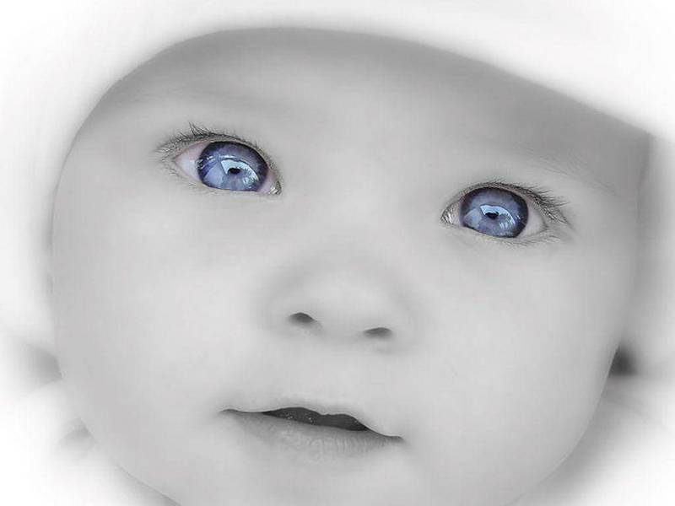
A day before the birth the child asked God:

Slide 3
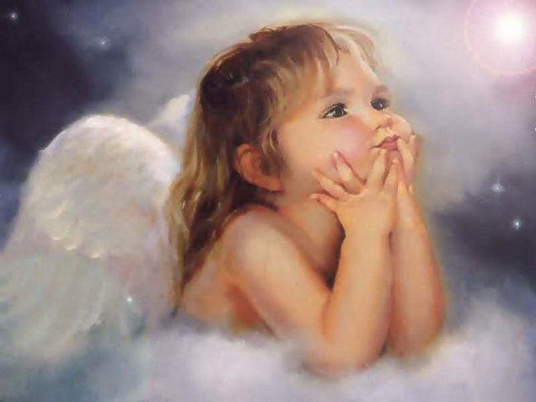
— I don't know, why I go to this world. What do I have to do?

Slide 4
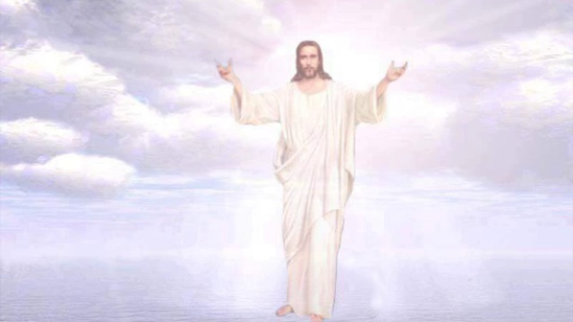
God answered:
— I will present an angel to you who always will be near you.
He will explain everything to you.

Slide 5
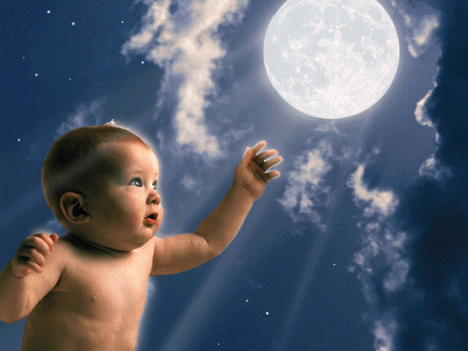
—How will I understand it,
I don't know its language?

Slide 6
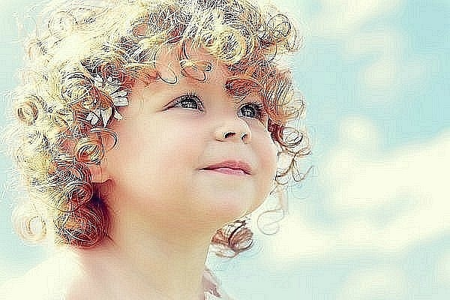
— The angel will teach you to the language. It will protect you from all troubles.

Slide 7
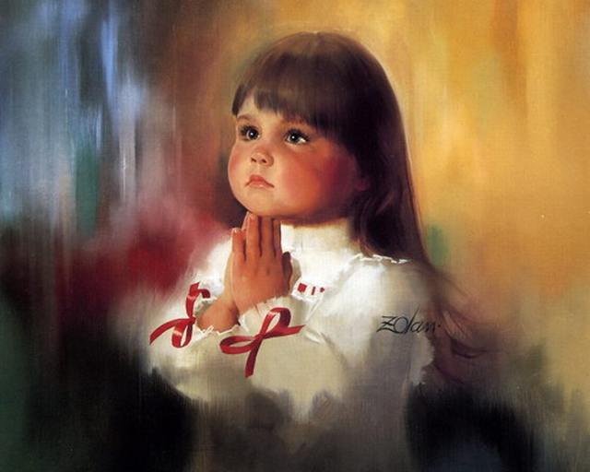
— How and when I have to return to you?

Slide 8
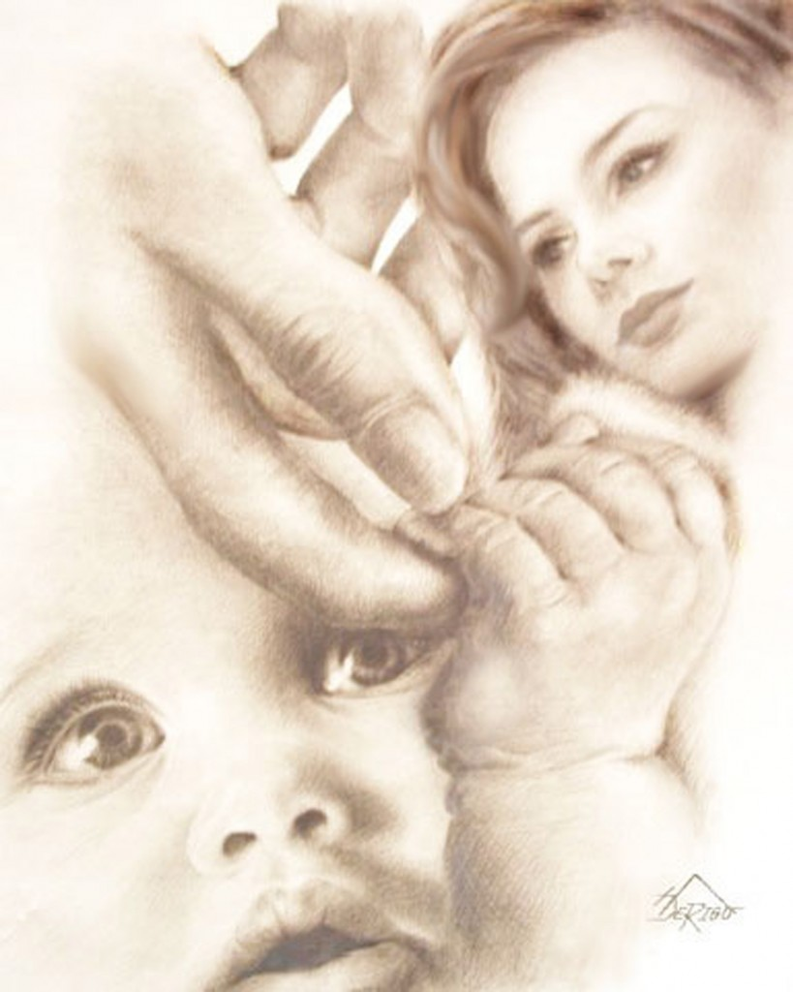
.
— Your angel will tell you everything.

Slide 9
- And what is the name of the angel?

Slide 10
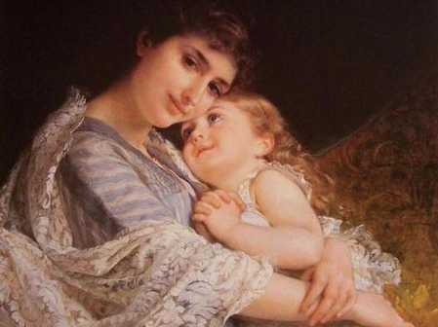
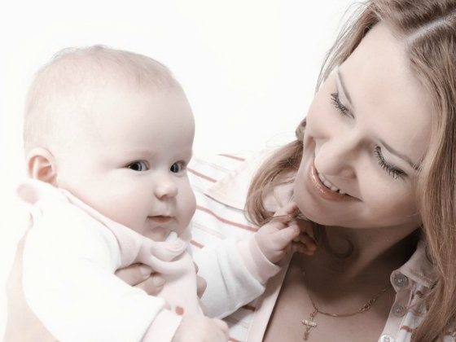
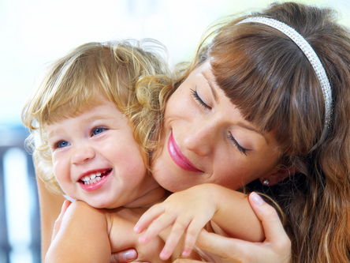
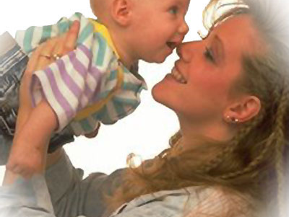
— No matter, what his name is, it has many names.
You will call it .
"Mother"

Slide 11
What does your mother look like?
What is she wearing?
What does she usually wear?
What is she like?

Slide 12
И. Бах

Slide 13
Ш. Гуно

Slide 14
Бах - Гуно

