Slide 1
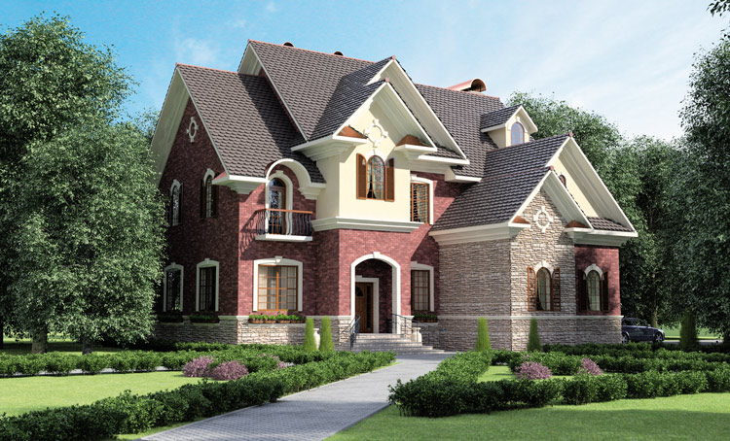
Typical English House.
Презентация
к уроку английского языка
Выполнила
Желтоножко Анна Владимировна
учитель английского языка
ГБОУ школы №471

Slide 2
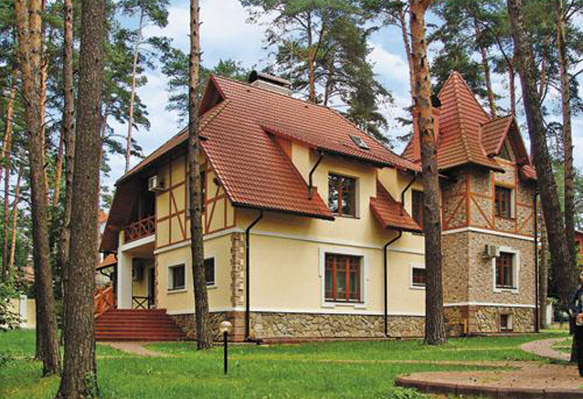
Traditionally English families prefer to live in big houses in suburb far from the crowded cities.

Slide 3
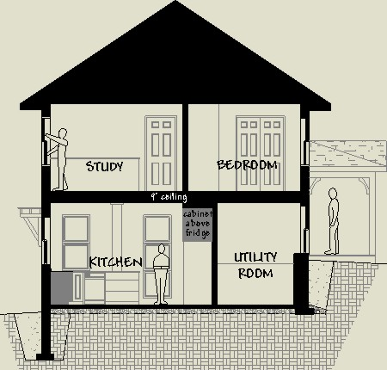
Usually there are two floors in a typical English house.

Slide 4
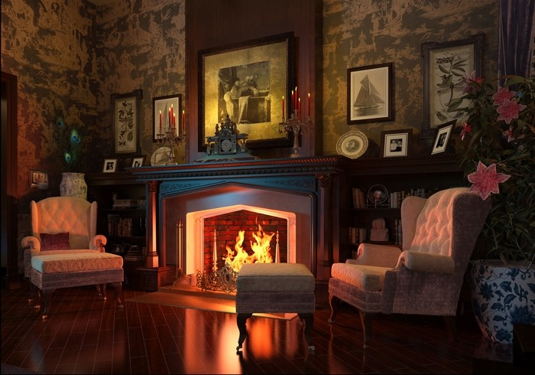
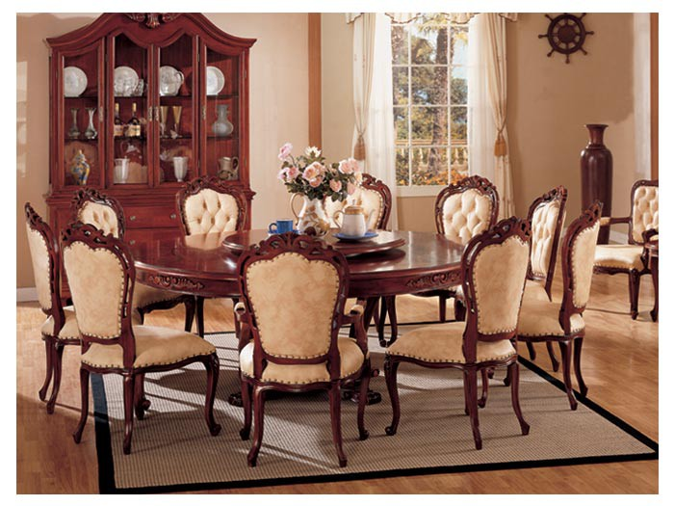
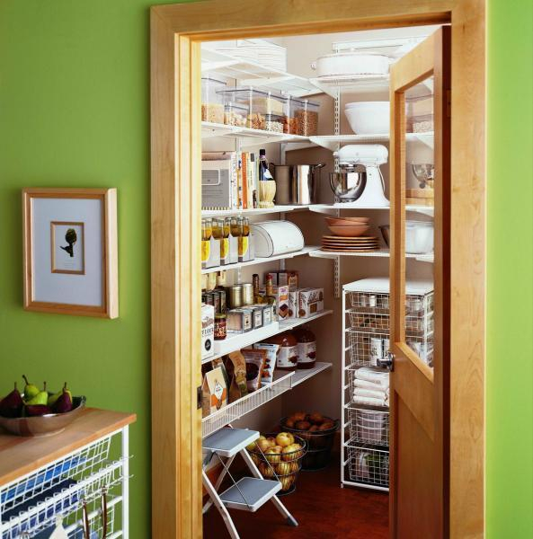
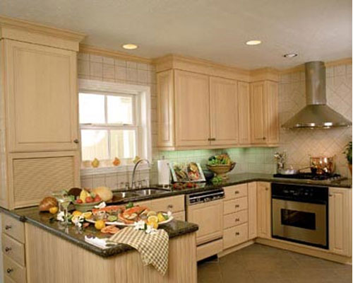
There is a hall, a kitchen, a living room, a dining room and a pantry downstairs.
living room
pantry
dining room
kitchen

Slide 5
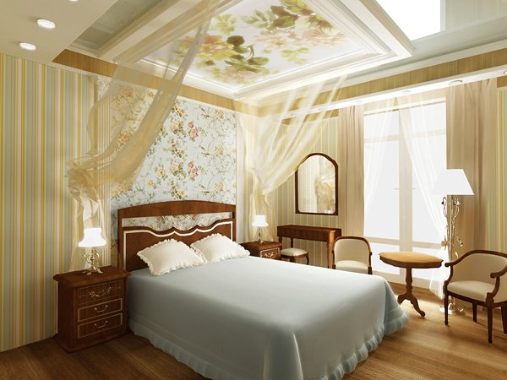
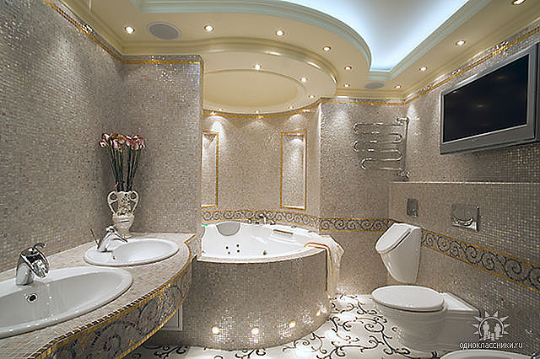
There are bedrooms and bathrooms upstairs.

Slide 6
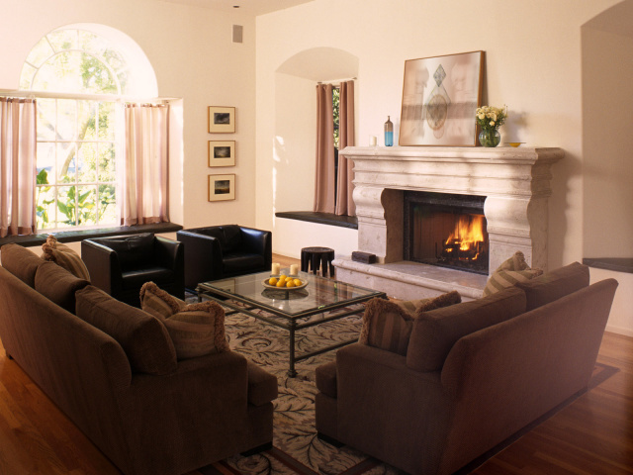
LIVING ROOM
In their living room they usually have a fireplace. It is the symbol of a typical English house. They like to spend the cold rainy evenings sitting at the fireplace and talking or watching TV or just reading a book.

Slide 7
DINING ROOM
Dining room is the part of the house where the family sit at the dinner-table and have meals. It’s usually a spacious room with big windows.

Slide 8
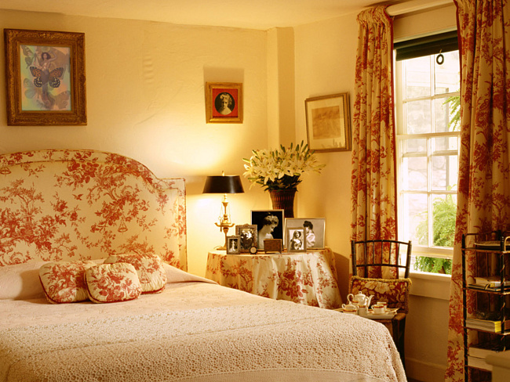
BEDROOMS
As a rule English people make their bedrooms upstairs. For more comfort there are bathrooms next to the bedrooms on the same floor. Usually each member of the family has his/her own bedroom.

Slide 9
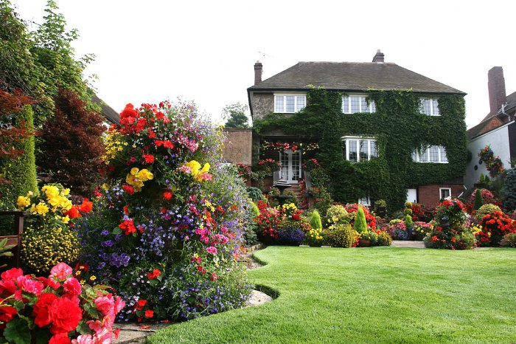
Usually there is a garden around the house. It’s rather beautiful with a lot of trees and flowers in it, because all English people like growing flowers and fruit trees.

Slide 10
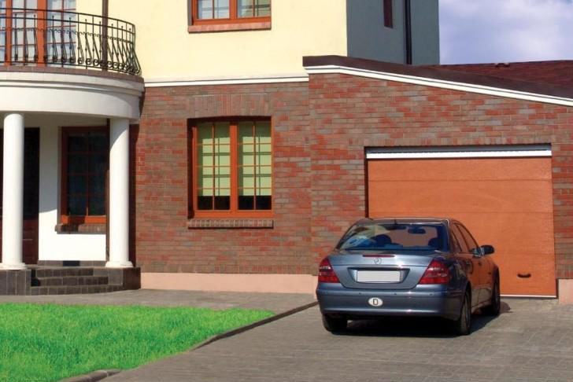
Traditionally there is a garage near the house or on the ground floor. All British families have cars of their own. They need cars to get to work, to bring children to school or to get to the city on business.

Slide 11
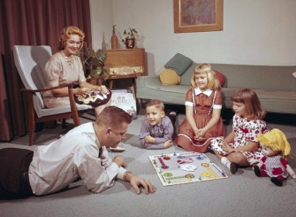
There are perfect proverbs the English often use:
“There’s no place like home!”
“East or west – home is best!”
When they return home they like to say: ”Home, sweet home!”

Slide 12
Answer the questions:
How many floors are there in the typical English house?
Are there bedrooms upstairs or downstairs?
Where do they have the fireplace?
What is there near the house?
In what room do they have their meals?

