Slide 1
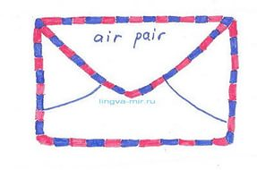
Informal letters/emails
(Неформальное письмо)

Slide 2
They are sent to:
Friends;
relatives

Slide 3
Types of the letters
Invitations
Accepting& refusing Invitations
Asking for & giving permission
Apologising
Asking for& giving advice
Giving news
Expressing thanks/ congratulations

Slide 4
The letter consists of:
(address) Saint-Petersburg
Russia
15/10/2015
Dear Phill, (Informal greeting)
Thanks for your letter. Hope you are well. (Opening remarks)
(Main body)(может быть несколько параграфов)
Well, that`s all for now. Write back soon. (Closing remarks)
Best wishes, (Subscription)
Ann (Signature)

Slide 5
Informal style:
Phrasal verbs (turn up; look after; put on)
Idioms (drop me a line)
Informal linkers (and; so; but; well)
Short forms (I`m; you`re; can`t)
Indirect questions (You ask me if I go for a walk)

