Slide 1
Dreams & Nightmare

Slide 2
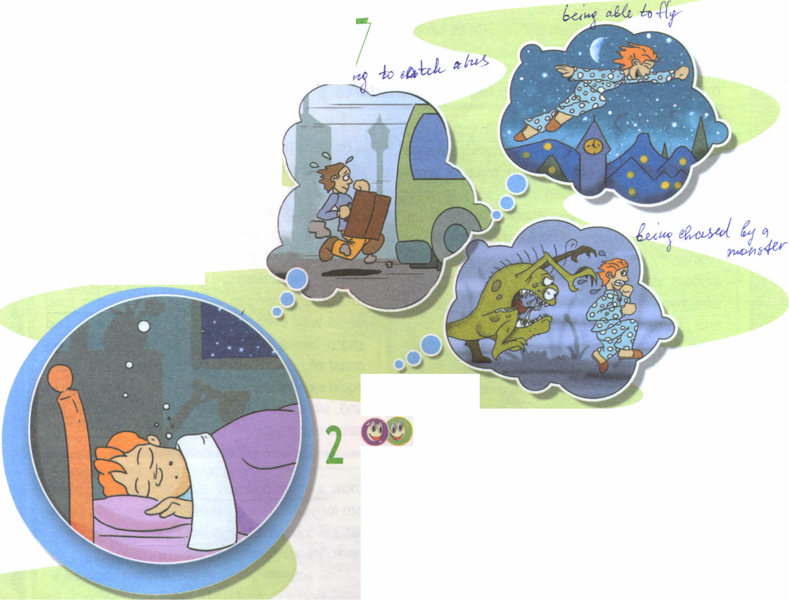
Dreams & Nightmare

Slide 3
How often do you remember your dreams?
How often do you have nightmares?
What kind of things do you dream about?
Have you ever had a dream or nightmare over and over again?
(What was it about? How did you feel?)
Do you think dreams have meanings?
1 2

Slide 4
Complete the sentences
Lizzie didn`t sleep well because…
In her dream, Lizzie was finding it difficult to…
In her dream, Lizzie`s legs…
Lizzie thought her dream meant she was going to…
she had a horrible nightmare..
get to an exams.
wouldn`t move.
fail her exams.

Slide 5
Find sentences in the dialogue which mean:
What`s the problem?
I`m sorry.
That`s awful.
Everything`s OK.
I feel better now.
What`s the matter?
Poor you!
Oh, that`s horrible.
Don`t worry.
That`s a relief!

Slide 6
Sweet dreams!

