Slide 1
English-speaking countries

Slide 2
Great Britain, the United States of America, Canada, Australia and New Zealand are English-speaking countries.

Slide 3
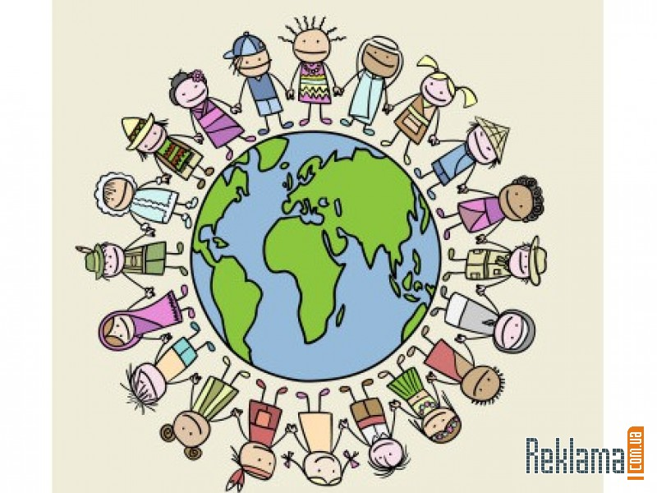
They are situated in different parts of the world and differ in many ways. The nature of these countries, their weather and climate and the way of life of the people differ.

Slide 4
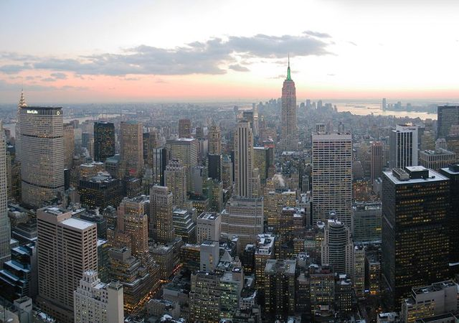
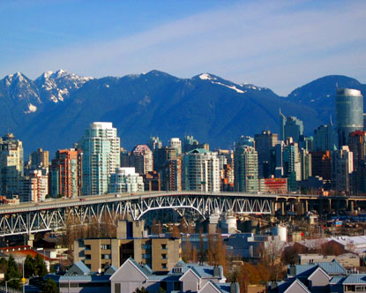
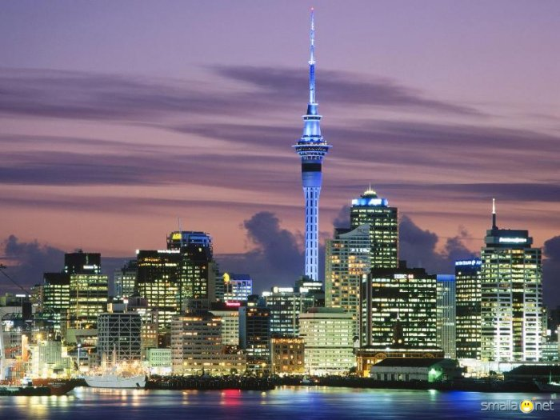
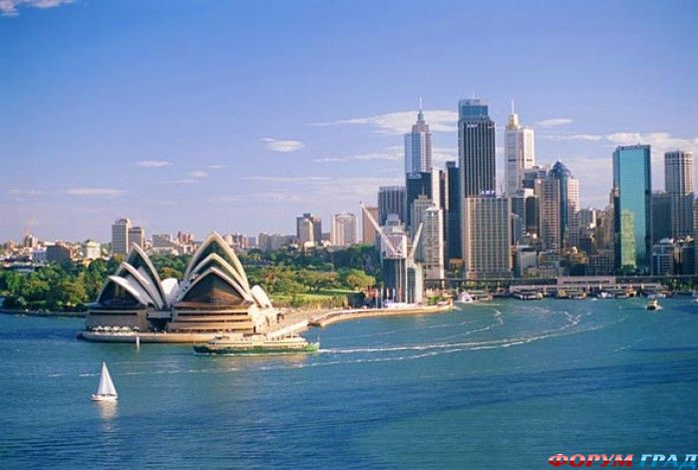
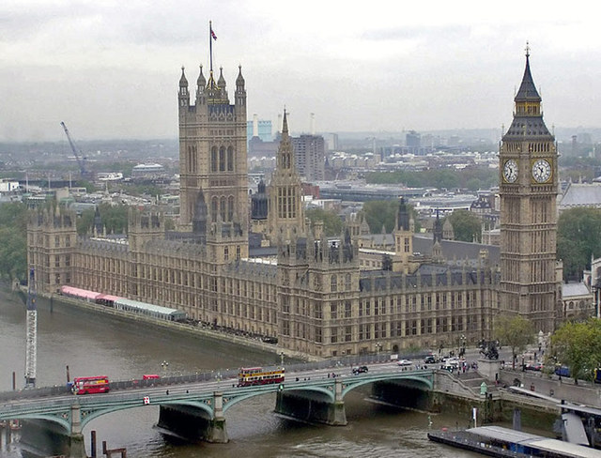
Each country has its own history, customs, traditions and national holidays. But they all have a common language, English.
Wellington
New York
Ottawa
Sydney
London

Slide 5
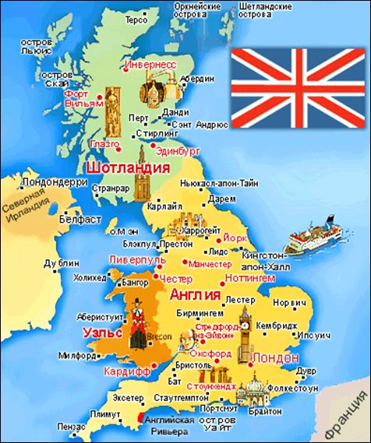
United Kingdom of Great Britain and Northern Ireland
United Kingdom of Great Britain and Northern Ireland consist of four parts: England, Scotland, Wales and Northern Ireland. The British Isles are group of islands on the north-west coast of Europe.

Slide 6
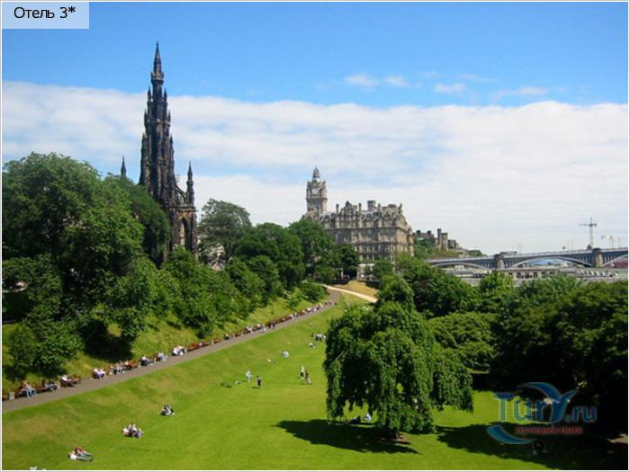
There are no high mountains, no long rivers, no large forests in the UK. The population of the UK is 56 million. The capital of the country is London.

Slide 7
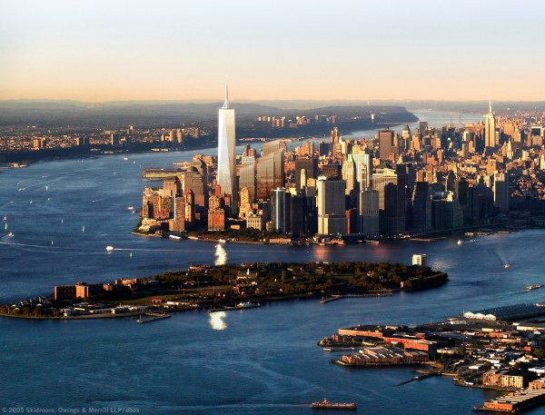
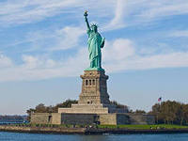
The USA
The USA is situated in the central part of the North American continent. The population of the USA is 236 million people. The capital city is Washington, D.C.

Slide 8
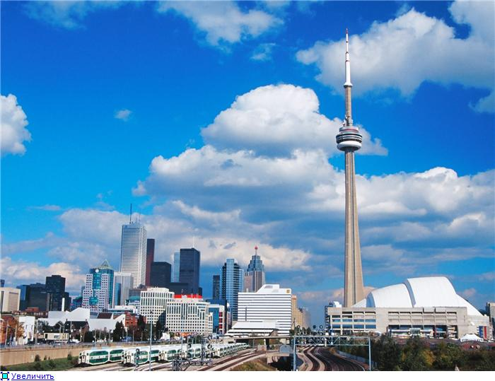
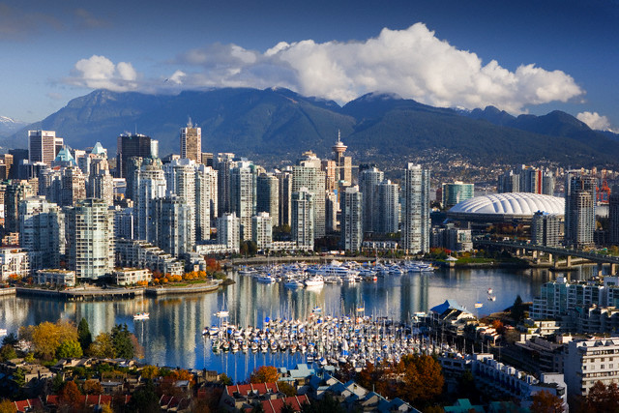
Canada
Canada has area of 10 million square kilometres. It is washed by the Pacific Ocean and the Atlantic Ocean. The population of Canada is 26 million people. The capital of the country is Ottawa.

Slide 9
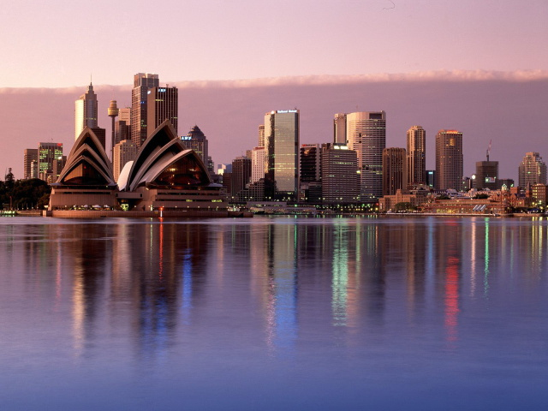
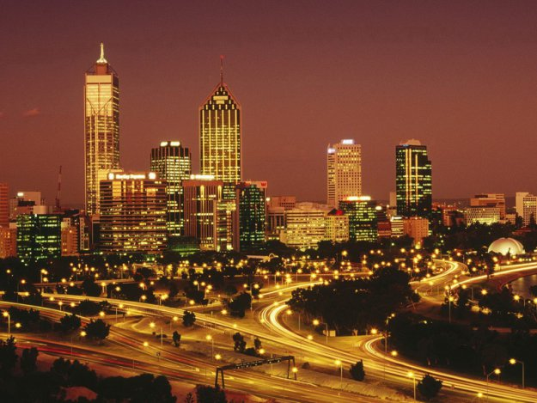
Australia
The territory of Australia includes the continent of Australia, the island of Tasmania and a number of smaller islands. The population of Australia is over sixteen million people. The capital of Australia is Canberra.

Slide 10
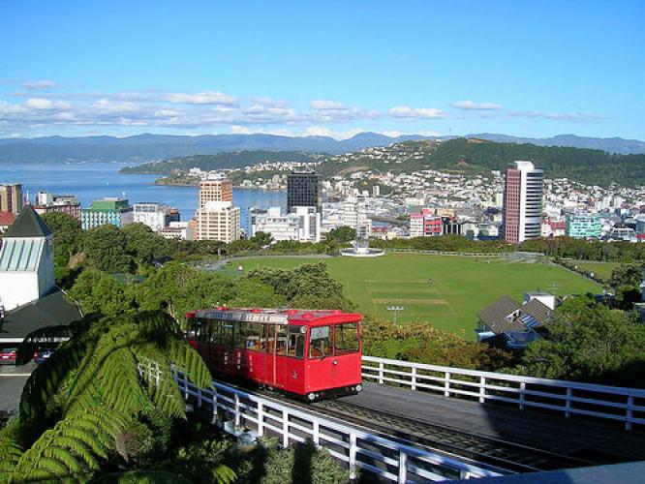
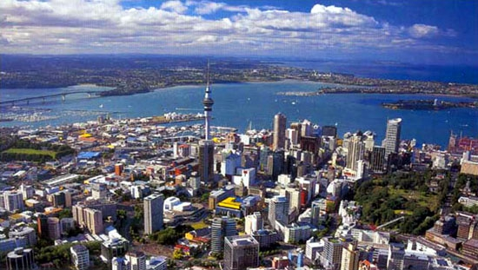
New Zealand
New Zealand is situated south-east of Australia. The country consists of three large islands. They are the North Island, the South Island and Stewart Island and also many smaller islands. The population of New Zealand is three million people. The capital of the country is Wellington.

